Slide 1
Knowing the Person with Dementia
Partnerships to Improve Care and Quality of Life for Persons with Dementia
Notes:
Welcome to the 10th presentation in the series Partnerships to Improve Care and Quality of Life for Persons with Dementia.

Slide 2
Training Goals
Goals for our series
Enhance family involvement in the daily care of their loved ones
Promote person-centered care
Goals for today
Discuss methods to develop “life stories” to guide daily care
Notes:
The goal for today is to discuss methods, both traditional and novel, for staff and family to collaborate to develop life stories for persons with dementia.
Life stories often include important values and experiences of the person with dementia, which can be used to guide daily care and activities. This module includes handouts that support and illustrate content in the presentation, so you may want to print them before you view this module.

Slide 3
Person-Centered Care
Person-centered care involves tailoring care to the person’s interests, abilities, history and personality
Family, caregivers, and the PERSON with dementia should be involved in developing plans
The person’s and family’s knowledge is essential to make sure the plan is right for them!
Notes:
As discussed in the two earlier modules, being person-centered means tailoring daily care to the person’s interests, abilities, history and personality.
Today we will continue to build on this topic by discussing methods to get to know the person with dementia. Knowing the person helps caregivers individualize daily care, so we will review some novel approaches to both gathering and sharing the person’s life story.
We also think it’s important to mention here that there is no one “right way” to get to know the person with dementia. Some of the ideas we will review may not fit very well with some care settings or services.
This is a lot like Partnership Agreements: We urge care teams and leaders to work together to adopt practices that are the best “fit” for the setting and staff.

Slide 4
Breakout Moment
If you had dementia and someone was caring for you . . .
What special things would you want your care providers to know?
What part of your life story might help guide your care?
What personal preferences would you want incorporated into your plan of care?
Notes:
Let’s start with a discussion breakout.
Imagine that you have dementia and someone is caring for you. What special things would you want your care providers to know about you? For example, how do you take your coffee? Do you have a particular routine for getting ready for bed? What life experience are you most happy talking about? What preferences would you want incorporated into your plan of care?
Please pause the presentation now and then when you are ready to continue on press play.

Slide 5
Gathering information
Partnerships in care: Assessment Inventory for person with dementia
Preferences: food, activities, clothing, daily routines
Likes and dislikes
Long-standing interests, history, experiences
Abilities and preferences change over time
Dementia progression
Acute illness, change in setting
Gathering information is ongoing!!
Notes:
As discussed in earlier modules, developing an effective staff-family partnership includes an assessment of the person with dementia, including their functional status, but also their values, preferences, likes and dislikes, and longstanding interests, history and experiences.
This information is critical to developing a care plan and a Partnership Agreement that best “fits” the person’s needs and preferences.
As the disease progresses, the person’s abilities, preferences and preferred routines may also change. Information needs to be re-evaluated on a regular basis.
Reassessment is important if there have been any acute health problems or changes in health settings -- like hospitalization. In turn, gathering information about needs, abilities and preferences is an ongoing process.

Slide 6
My Preferences
Likes/dislikes
Preferred routines
Abilities & assistance needs
Things that cause frustration
Things that provide comfort
Notes:
This form called, My Preferences, is included as a handout. This form can help caregivers gather information about the person with dementia’s preferences and typical routines.
Whenever possible ask the person directly. If they are not able to voice their preferences ask their family members or others who know the person well, like a close friend.

Slide 7
My Life Story
Childhood and past experiences
Favorite memories
Important dates, people, places in their life
Occupation, work history
Hobbies, interests
Notes:
Another helpful handout for use is called My Life Story. This form will help the provider to collect unique information about the person, their childhood, favorite memories, important dates, people and places in their life as well as current and past hobbies and interests.
Both the “My Preferences” and the “My Life Story” forms are available for use in the resources section of this training series.

Slide 8
Work, Hobbies, Interests
Work history
What does it mean to daily behaviors?
Can work-related interests be an activity
Hobbies
How can care providers support engagement?
What modifications may be needed?
Interests
Notes:
Working successfully with persons who have dementia often relies on conversations about their long-standing history and interests. Knowing about their work, hobbies and general interests can help staff engage the person in meaningful activities that promote their quality of life.
This history can also be used to help understand behaviors that don’t seem to “fit” a situation, and support them to do something enjoyable. For example, favorite foods that the person with dementia enjoys eating or recipes that they enjoyed baking or cooking may be gathered in a “memory book” as an activity to do with the person, and incorporated into the menu cycle.
If the person is upset, talking about baking their favorite cookies may help them redirect to happier thoughts.

Slide 9
Once information has been gathered . . .
SHARE THE INFORMATION!
Get history and interests off paper forms and into practice!
Data in “record” doesn’t help daily care
Requires teamwork and coordination
Think again about Partnership Agreements!
Share information among the team, with other providers
Notes:
There are many ways to gather information. The bigger challenge is getting information OUT of the medical records and INTO daily practice. The social worker or nurse may have collected information at the time of admission, and daily care providers may have learned about personal preferences, but unless there is a PLAN for sharing, the information does little good in shaping care.
So the next step is to share the information in useful ways – which means making information about the person easily accessible for use in daily care. In doing that, caregivers truly honor the person as an individual.

Slide 10
My Top Five
Quick access for caregivers
Highlights preferences
Most important things for caregivers to know
Share with other providers)
Send with the person during transitions
Notes:
One way to easily communicate and share the person’s preferences and interests is by using a form called My Top 5. Post a snapshot list of the preferred routine and key things to know about the person in a consistent location in each individual’s apartment or room.
That way caregivers will know exactly where to find the list for a quick reference for each person they are caring for. We suggest limiting the list to only key pieces of information so that caregivers can quickly read it while they are preparing to provide care. Because dementia care changes over time, remember to review the list frequently and keep it updated.
This form can also be shared with other providers such as therapy, or hospice, and sent along with the person in the event of a transition to another setting such as a hospital. The “My Top Five” form is also included in the resources section for the training series.

Slide 11
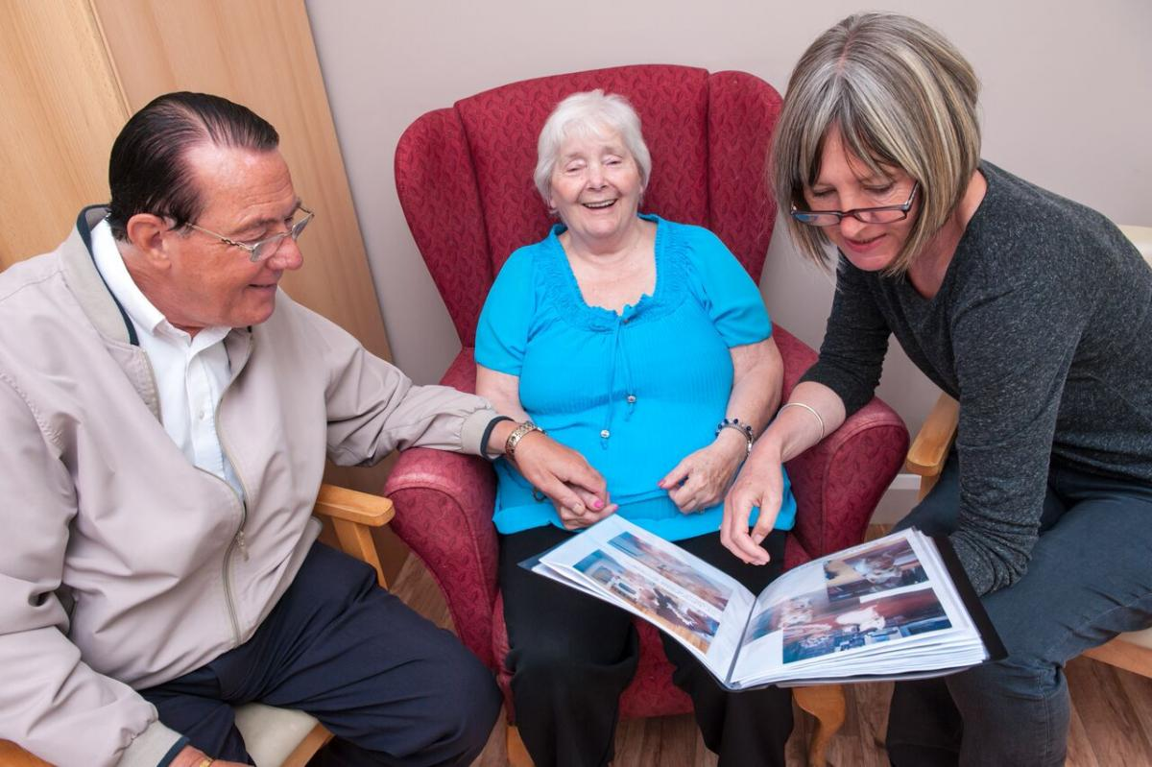
Life Story
Scrapbook/memory book
Framed collage/display board
Display of collections, favorite things
Video collage of family pictures
Voice recording of family sharing favorite memories, stories
Notes:
Another approach is to encourage family members to share their loved one’s life story through a scrapbook, memory book, framed collage or a display board in their home or room.
Other ways of sharing life stories could be through a video of family pictures or a voice recording of family members sharing favorite memories. Given that many Smart phones now have recording features, making sound or image recordings of the person or family can be done quickly and easily.
Sharing the person’s life story helps staff engage the person with dementia in conversation, and may be used to comfort and reassure the person during moments of confusion or agitation.

Slide 12
Resident Spotlight
Resident Spotlight wall
Memory boxes outside apartment or room
Highlight during:
Community birthday parties
Group activities
Community newsletter
Notes:
Life stories can also be shared through a Resident Spotlight. The person and their unique story can be featured physically on a dedicated wall in the care community for staff, family and other residents to view – or in personalized “memory boxes” that are close to the person’s apartment or room.
Other ideas include featuring stories during group activities, like birthday parties, or in the provider’s newsletter, website or even through social media.

Slide 13
Veteran’s Wall of Honor
Notes:
For those who have been active in the military, a wall of honor is a great way to acknowledge their service. Some individuals may have a photo from their time in the service to display, or they may prefer to use a current photo.
This type of activity can provide opportunities for reminiscence for many older people and family alike, which adds to the sense of knowing one another.

Slide 14
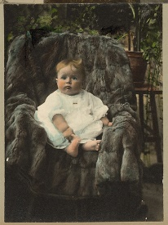
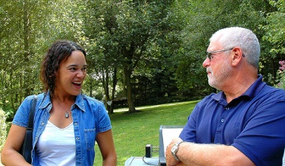
Sharing Life Stories
Who rode an Indian motorcycle from Florida to California in 1944?
Create a game for staff
Share a piece of a resident life story; staff guess
Who is that beautiful baby?
Post baby pictures of residents
Staff-person “pals” program
An hour just to talk, on the clock
Notes:
A novel idea that one provider shared is to create a game for staff meetings. In this example, each regular staff meeting starts by sharing a piece of a resident life story and then they have staff guess who the resident is. The game is said to be a fun ice-breaker to start their meetings as well as a great way to get to know their residents.
Another game is called “Who is that beautiful baby?”. Baby pictures of residents and staff are collected and displayed without names. Everyone – staff members, residents and family members all try to guess who is who. This can be a great way to get to know not only the individuals being cared for, but also to celebrate the caregivers.
A third activity that was shared by staff caregivers was having individual staff members be “pals” with individual residents. In this program, staff were given paid time to just talk with residents – without the expectation of doing any cares. This helped staff get to know the resident, and in turn, share that information with others.

Slide 15
Sharing goes both ways
Partnerships also includes families and persons with dementia getting to know their caregivers
Staff spotlight in community newsletter, website, social media
Honor cultural diversity, traditions, celebrations
Invite staff to bring their families to community events and activities
Notes:
It is important to note that sharing stories and interests in the partnership approach goes both ways. Family members and persons with dementia also enjoy getting to know their caregivers. Some providers encourage their staff to create their own life stories to share with the persons they care for and the family members. This promotes finding common interests that further develop a positive and trusting partnership.
Another approach is to include a staff spotlight along with the resident spotlight in community newsletters, websites or their social media page.
Other ideas for helping staff and residents find common interests include:
creating events and activities on different cultural traditions and celebrations
involving families, staff, and residents in planning events
inviting staff to bring their own families to community events.
There are many creative approaches to encourage staff members, persons with dementia, and family members all get to know one another! And in turn, a sense of trust and “being family” often grows.

Slide 16
Summary
Many choices for getting to know the person with dementia! Remember to
Work closely with families
Gather AND share information
Stay PERSON FIRST!
I may be forgetful, but I still have my mind.
I may speak slowly, but I still have my voice.
Don’t focus on what I am losing.
Honor what remains.
Notes:
There are many ways to know the person with dementia. Learning about the person’s longstanding history and experiences helps caregivers understand and respect individualized likes, dislikes, preferences and preferred routines.
The best approaches to knowing the person with dementia involve working closely with family and other providers to gather and share information that contributes to high quality, person-centered care.

Slide 17
Coming up next
Goal-Directed Care: Identifying and Using Values to Direct Care
Identifying personal and family values
Using values to help guide care decisions
Importance of starting the discussion early
Notes:
Goals of care in dementia often change as the disease progresses. In our next presentation we will focus on identifying personal and family values that may help guide care decisions.
We will also discuss the importance of early conversations and information-sharing with family related to their goals to reduce both stress and crisis-based decisions, and to advance “person-centered” care and treatment decisions.

