Slide 1
Family-Staff Partnerships: Part 2
Partnerships to Improve Care and Quality of Life for Persons with Dementia
Notes:
Welcome to the 6th presentation in the series Partnerships to Improve Care and Quality of Life for Persons with Dementia. This is the second module about the Family Involvement in Care Intervention.

Slide 2
Training Goals
Goals for our series
  Enhance family involvement in the daily care of their loved ones
  Promote person-centered care
Goals for today
  Review principles of negotiation use in Step 3
  Describe conflict resolution and how it works in negotiation
Notes:
Our goals for today include reviewing principles of negotiation-use in Step 3 of the Family Involvement in Care Intervention, and then describing how conflict resolution works in negotiation.

Slide 3
Family Involvement in Care (FIC) Intervention
Orient family to the setting and the idea of partnership
Educate staff
Negotiate and form partnership agreement with family
Educate family members about staying involved in care
Evaluate and renegotiate the agreement as needed
Notes:
Today we’re going to talk more about Step 3, we will focus on the actual process of negotiation, and how that works in the Intervention.

Slide 4
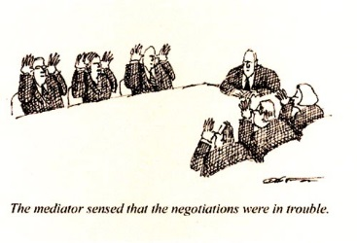
Step 3. Negotiation
Negotiation isn’t just for corporate board rooms!
Negotiation is working side-by-side with another person to achieve mutually satisfying results
Notes:
Negotiation is a big word that is often linked to corporate board rooms. But in fact, it’s a process we all use in daily life. Negotiation is really just a “give and take” process.
It means working side-by-side with another person to find mutually satisfying results.
Negotiation in the Family Involvement in Care Intervention means bringing staff and family caregivers together, to reach an agreement on the goals and delivery of care for the person with dementia.
Like other negotiations, the goal is to reach an agreement that is satisfactory to both parties – staff and family.

Slide 5

Step 3. Negotiation
Cooperative Negotiation = Win-Win
  Resolve possible conflict over who controls or provides care (or parts of care!)
Negotiation = Means to overcome differing views that cause conflict
Negotiation = Skill that can be learned
  Review basic techniques
  Apply to partnership agreements
Notes:
Negotiation, when done in a cooperative manner, can lead to a win-win situation, where both parties are satisfied with the outcome.
Negotiation can be used to overcome differing points of view about care of the person with dementia. Both the family members and the caregiving staff have common interests: To provide the best care possible for the person with dementia, and to avoid conflict with each other.
Negotiation, and particularly COOPERATIVE negotiation, is a skill that can be learned and practiced. This training series will introduce some techniques – and also some pitfalls to avoid.

Slide 6
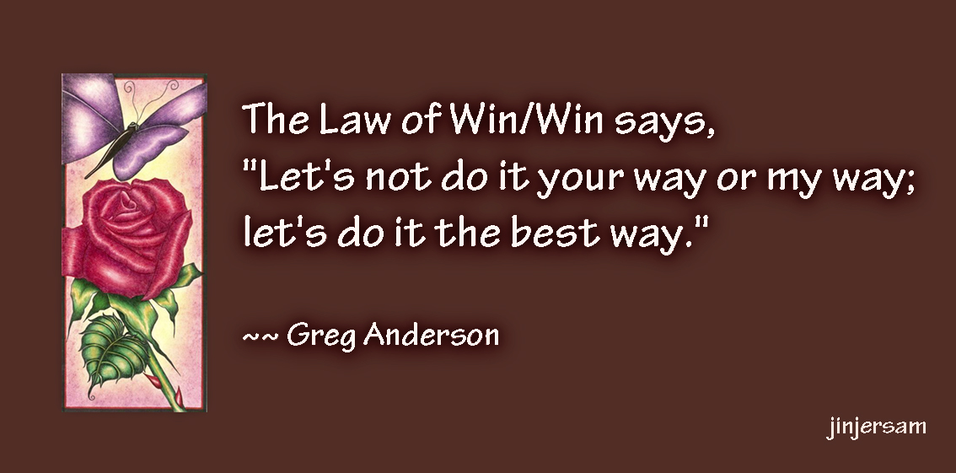
Step 3: Negotiation
Use the “law of win-win” to guide decisions
Notes:
The goal of cooperative negotiation, which is aimed at arriving at a “win-win” agreement, relies on staff and family members each working to understand the other’s point of view. It’s a give and take process.
The point isn’t to convince the other party to do things our way; the goal is to find the best solution for the problem or care question – the solution that has the most benefit for the person with dementia.

Slide 7
Back to the beginning . . .
Family Involvement in Care = A trusting partnership between staff and family in providing care for the person with dementia
Deliberate process to involve family
Negotiation allows family and staff to identify SHARED goals
Sharing information and goals leads to a trusting partnership!
Notes:
The Family Involvement in Care Intervention is a deliberate process to involve the family members in assuming some control and responsibility for caregiving.
Negotiation allows staff and the family caregivers to share control and power in determining the goals of care, and in providing care for the person with dementia.
Instead of staff directing the person’s care, which can lead to family members feeling dependent on the staff, the process involves sharing information and goals, which leads to a trusting partnership.

Slide 8
Big role change for many of staff
Norm → Health care providers and staff caregivers are the “experts” who have the “answers”
Being EQUAL partners with family requires change
  How you think about your and their roles
  Modifying expectations and behaviors
  Not “taking control” of person’s care
Negotiation: plan together
  Help resolve conflicts
  Blend differing points of view
Notes:
Working with family members as PARTNERS is a big role change for most staff caregivers and providers. The “norm” is that the health care providers are the “experts” – the ones who have the answers and direct care.
Moving away from acting as a “superior” to being equal partners with family members requires modifying your roles and expectations. It is not easy for most staff to stop thinking of themselves as the experts and to not take control of the person’s care.
The same is true for family members. It’s not easy for the family members to think of themselves as an active participant in care and decisions – particularly in residential settings. These new roles will take time and practice to achieve satisfaction in the improved care for the person with dementia.
Through negotiation, family and staff can understand and implement a plan together to address common concerns about the person with dementia. Negotiation helps resolve conflict that can result from differing points of view between staff and family members.
So before we talk about the actual Negotiation Session, let’s explore possible sources of conflict that can surface between staff and family members.

Slide 9
Sources of Conflict
Staff and family: Different perceptions (viewpoints)
Conflict: Disagreements about MOST important care activities
Negotiation: Differences may trigger emotions, behaviors
EMOTIONS
Defensiveness
Hostility
Judgements
BEHAVIORS
Lack of knowledge
Lack of follow-through
Reluctance to try new things
Notes:
Although staff and family members both have the goal of providing high-quality care, they may not see things the same way. Each is likely to have their own perception – or point of view, about the person and care. Conflict results when family and staff disagree on what each perceives to be important activities for the person’s care.
In turn, the potential for conflict is present when staff and family caregivers discuss their perceptions and expectations during the Negotiation Session.
Remember: having different points of view aren’t “bad”! In fact, we often learn something from hearing another person’s viewpoints. The bigger problem is how we REACT to having different points of view. Emotions and behaviors can both be huge “road blocks” to being partners in care.

Slide 10
Breakout Moment
Mrs. Smith is very upset that staff part her husband’s hair on the right side instead of the left. She considers this such a “simple thing” and easy to do and it is very important to her that he look neat and well-groomed.
Staff view her concern as nitpicky and critical of them. They think she overlooks how attentive they are to getting him up, dressed in clean clothes, and hair combed before she (Mrs. Smith) arrives each day.
Staff’s goal: Have Mr. Smith well-groomed AND get their work done.
Mrs. Smith’s goal: Have her man look the way he did all of his life which helps ease her sense of loss.
Notes:
Let’s take a minute for a breakout discussion.
Consider this situation: Mrs. Smith is very upset that staff have been parting her husband’s hair on the right side instead of the left. She considers this an important part of his care to maintain his appearance the way he always kept himself.
Staff feel that Mrs. Smith is being overly critical of this detail to his morning routine and feel that it is impossible to make her happy.
Please take a minute to discuss the conflict and some of the emotions involved. When you are ready to continue the presentation, press play.

Slide 11
Example: Sources of Conflict
Defensiveness: responding to emotions instead of facts; staff thought Mrs. Smith was accusing them of poor care
Hostility: acting or reacting in an unfriendly way; Mrs. Smith’s view that it’s “such a simple thing” may trigger defensiveness
Judgments: Staff view Mrs. Smith as nitpicky
Lack of knowledge: Neither really understood the other’s view
Notes:
Some of the emotions and behaviors that may contribute to conflict in the situation between Mrs. Smith and the staff are listed here.
As we discussed in the module Interacting with Family Members, working to overcome our reactions – which is often full of negative thoughts, feelings, and emotions – is important.

Slide 12
Negotiation in dementia care
Many questions and challenges in providing care & treatment
  Loss of abilities over time
  New, different demands and needs
Differences in opinion are likely to emerge
  Values or beliefs about options/choices
  Real-life constraints: time, money, personnel
  Understanding of issues
Focus on how concerns are expressed AND mutually satisfying solutions!
Notes:
The very nature of dementia makes negotiation skills important. The loss of abilities over time means that care demands and needs are ever-changing. And in that process, there are bound to be differing points of view about the best approach to care.
For example,
Family members view their loved one as lacking the ability to do a task when staff are encouraging him or her to perform – or maybe the opposite.
Other issues are likely to revolve around real-life problems and demands – and how realistic family members may be about what staff can or should do – or maybe the opposite!
In short, having different views isn’t a problem, it’s how concerns are expressed, and how willing staff and family members are to focus on reaching a mutually-satisfying solution.

Slide 13
Negotiation in dementia care
Achieving mutually satisfying results applies to lots of questions
  What does this behavior mean?
  Is this medication really helping? Or is it making things worse?
  What is the best way to stay engaged?
  What is reasonable to expect?
    Home health, adult day care
    Residential, nursing facility
    Primary care, specialty providers
Notes:
A wide variety of topics and questions may benefit from using negotiation to find the best solutions.
For example, a provider may suggest using a medication to reduce risks of wandering and exiting behaviors, but family members are worried about the sedating effects. The back and forth discussion can help identify alternative methods, like activity engagement or household adaptations.
Another important consideration is that the person with dementia may use a variety of services over time. Staff involved in home health care or an adult-day health program may help families find other sources of assistance – like residential or nursing home care.

Slide 14

Summary
Negotiation
Skill that is learned & practiced
Key to avoiding conflicts
Foundation for building trusting partnerships with family
  Shared control and power in setting goals, providing care
Notes:
Negotiation does not come naturally; it is a skilled that is learned and practiced, and can be key to avoiding conflict. The use of negotiation in a partnership relationship helps to build the foundation for trust between staff and family caregivers.

Slide 15
Coming up next
Family-Staff Partnerships: Part 3
Conducting the Negotiation Session
Step 5. Evaluation and Renegotiation of the Partnership Agreement
Notes:
The next module about family-staff partnerships will review some of steps in the actual Negotiation Session that is part of Step 3. We’ll also review the important process of evaluating the Partnership Agreement, and re-negotiating it as the person’s needs change.

