Slide 1
Staying Person-Centered: Opportunities and Methods
Partnerships to Improve Care and Quality of Life for Persons with Dementia
Notes:
Welcome to the 9th presentation in the series Partnerships to Improve Care and Quality of Life for Persons with Dementia.

Slide 2
Training Goals
Goals for our series
  Enhance family involvement in the daily care of their loved ones
  Promote person-centered care
Goals for today
  Taking a person-centered approach in daily interactions.
Notes:
The goal today is to discuss how to take a person-centered approach in daily interactions with a person with dementia – even when you may not know the person well.

Slide 3
Quick Review: Person-Centered Care
Person-centered care involves tailoring care to the person’s interests, abilities, history and personality
Family, caregivers, and the PERSON with dementia should be involved in developing plans
The person’s and family’s knowledge is essential to make sure the plan is right for them!
Notes:
As we discussed in the last presentation, being person-centered means tailoring daily care to the person’s interests, abilities, history and personality. The person with dementia and their family members should be involved in developing plans for care.
Their input is essential to making sure the plan truly fits the person and his/her individual characteristics and needs.
Source: Alzheimer’s Society, UK; www.alzheimers.org.uk/info

Slide 4
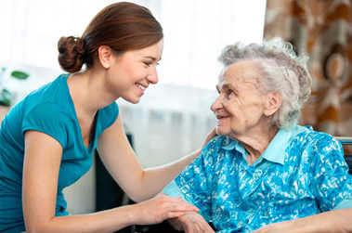
Assessment is part of FIC Intervention
Person with dementia
  Functional abilities?
  Self care abilities?
  Cognitive function?
  Pleasurable activities?
Also consider . . .
  Values
  Preferences
  Goals for care, treatment, engagement
  Longstanding interests, history
  Personality
  Life experiences
Notes:
We hope that the Family Involvement in Care Intervention process will help you identify, and use information about the person in order to stay person-focused in care. Being person-centered often relies on understanding the individual’s
level of function in daily activities,
physical self-care abilities,
cognitive function, and
preferred recreational or leisure activities.
The Family Involvement in Care Intervention also encourages care providers and staff to learn about long-standing values, preferences, interests, personality, and experiences that will guide person-centered care.

Slide 5
Knowing the person is great, but…
Being person-centered doesn’t depend on having all the “facts”!
Thought-FULL approaches to care make all the difference!
Use values and principles to guide PERSON FIRST care!
  Providing respect
  Assuring dignity
  Considering the person’s viewpoint
  Offering choices
  Supporting self-care: avoid doing things TO the person
Notes:
Of course there are many situations when you don’t KNOW the person with dementia yet. You or they may be new to the care or service situation and you haven’t done an assessment of their needs or characteristics. However, being person-centered doesn’t depend on having all the “facts”.
Thoughtful approaches to care make all the difference in caring for the person as a human being. As before, psycho-social and disease-related factors interact to determine quality of life.
When you don’t really know the person, use the values and principles of person-centered care to guide how you approach care. Think PERSON FIRST. That means
Providing respect for the person as a human being
Assuring dignity in all approaches and care
Considering how the person looks at the situation from their viewpoint,
Offering choices the person can make, and
Supporting the person to be as independent as possible in care. In other words, don’t DO things TO the person. Help them do things themselves!!

Slide 6
Need-Driven Dementia-Compromised Behavior Model
Individual factors [Stable]
Environmental factors
[Fluctuating]
Cognitive function
Physical function
Longstanding personality
Habits, traits
  Physical needs
  Psychological needs
  Social environment
  Physical environment
Behavioral & Psychological Symptoms
Notes:
This is a good time to think about the Need-Driven Behavior model, and how caregivers can often influence factors in the person’s environment.
For example, physical needs include things like hunger, pain, being cold, or needing exercise. Boredom and loneliness are common unmet social needs.
The physical environment includes things like television, too many people talking at once, lighting that is too bright or too dim, and much more. These factors continuously change and interact with longstanding abilities and preferences.
By identifying and addressing unmet needs, caregivers can often reduce or prevent troubling behaviors – AND help to provide comfort to the person with dementia.

Slide 7
One-minute assessment
Particularly if you don’t know the person well
STOP and think
Observe behaviors
Listen to their words
Think about facial expressions/gestures
How is the person feeling?
What is going on in their “viewpoint”?
Notes:
An important approach in staying person-centered is using a “one-minute assessment” before initiating conversations, or care with a person with dementia.
STOP, think, and observe the person. Take a minute, literally 60 seconds, to consider the person’s current behavior, what he or she is saying and doing, and facial expressions or gestures.
What does it seem to mean? How does the person seem to be feeling? Try to look at the world from their point of view. For example, is it too dark for them to see you? Is background noise from a television, radio or others talking going to interfere with your ability to talk to the person?

Slide 8
One-minute assessment
Gauge next steps based on what you learn
What is going on in their world right now?
How can I best approach?
How can I avoid pushing or rushing them?
Notes:
Taking a minute to think about the world from the person’s perspective can help caregivers decide HOW to approach the person.
For example, thinking about what is going on in THEIR world can prevent you from startling them. If they are comfortable and dozing, even a gentle touch might frighten them. And if they are restless and irritable, a calm and reassuring approach that tries to understand WHY they are uncomfortable often helps.
The point is, use what you observe to determine how to best approach the situation and their care. Most of the time, the best approach avoids pushing the person to perform care tasks, or rushing them to complete activities.

Slide 9
Basics: Show Respect
Show respect, caring through your approach
Ask what the person prefers
Limit choices
Use verbal/nonverbal communication
Monitor your behavior/tone/expressions
Approach from front or side, get to their eye level
Notes:
There are some “basics” in dementia care that tend to produce better quality outcomes for people with dementia. As before, using the values and principles of person-centered care can help caregivers use practices that RESPECT the person, whether you know them well or not. For example,
As much as possible-ask the person what their preferences are for all care activities
Limit choices to ones that the person can make. Rather than asking open-ended questions, ask the person to choose using an “either or” option with two choices.
Point, cue, or show the person what you mean to help get your message across.
Monitor your own behavior, tone of voice and facial expressions to best assure the person is connecting with you, and not reacting to your frustration with the situation.
Approach the person from the front or side and if they are sitting or in a wheelchair, sit down to be at their eye level.

Slide 10
Basics: Active Communication
Verbal and non-verbal messages both matter!
Short sentences, simple words, no jargon
Avoid pronouns like “it,” “that,” “there,” - be specific
Use terms the person understands
Monitor non-verbal language and gestures
  Monitor tone of voice, facial expressions
  Point, illustrate
  Help the person get started with the task
Notes:
The idea of active communication also applies to how caregivers interact with people with dementia.
Adjusting your communication style can be very helpful when engaging the person in their care. Using short phrases, simple words, and avoiding jargon can help the person “follow” the message – that is, they are less likely to become confused by not understanding your message.
Be specific and use terms the person understands.
Think about your nonverbal language and gestures.
Monitor your tone of voice and facial expressions – work to show care and compassion through your appearance and words.
You can also help convey your message by pointing or illustrating a task to help the person get started.

Slide 11
Basics: Person First
Slow down and think about the person
Use calm, caring, compassionate approach and routine
Adjust your approach to fit the “moment”/day
Accept changing abilities
  Do not try to reason
  Do not ask to “try harder”
Tailor care to fit needs
Notes:
One thing busy caregivers seem to forget is the value of SLOWING DOWN and thinking about the person with dementia. This is what is meant by PERSON-FIRST care.
Person-centered care uses a calm, caring, compassionate approach that communicates “I care about you.” As before, constantly thinking about the PERSON and not the routine or task demands is key.
Adjusting to the “moment” in care means you may not expect reactions, but can respond in a way to reassure, calm or distract the person.
Accepting that changes in the person’s abilities are part of the disease is also important. How a person with dementia interacts and responds can be different from one day to another, and will change over time.
Avoid trying to reason with the person or ask them to “try harder” to complete a care task. This will likely only cause more stress for both the person with dementia and caregivers. Instead, work to adjust your approach to fit their needs. That’s what is meant by “tailoring care” – caregivers make routines fit the person’s needs.

Slide 12
Basics: Engage in Conversation
Engage the person in the task/discussion
Engage/guide through care routines and tasks
Ask questions about past habits
Discuss present interests
Talk, sing to distract
Notes:
Another important aspect to staying person-centered is engaging the person in conversation. In too many situations caregivers forget to talk with the person, or tell them what they are doing and why.
The value of having conversations and relationships means that caregivers should actively engage the person in the care task. Guide the person through what is being done, how, and why, with step-by-step instructions if needed.
Having conversations can also include asking questions about their past habits or their present interests. This serves the dual purpose of helping you know the person better, AND taking their mind off the task at hand. In some situations, singing a song that the person enjoys can provide a positive distraction – for example, during a shower.

Slide 13
Basics: Engage in Care
Keep it simple
  Break task into steps
  Distract, redirect with a positive approach
Work at the person’s pace
Follow their lead
  Resistive? Try again later
  Work to follow personal habits, routines
  Avoid “push-back”
Notes:
As suggested earlier, another key is to keep things as simple as possible. Break the task into smaller, more manageable steps. If the person responds in a negative way, work to redirect their attention to something more enjoyable. For example, this may be a good time to ask about their life history, or earlier experiences.
Always work at the person’s pace. Try to not rush or hurry them. Instead, follow their lead. If they resist you or the task at hand, take “a minute” to consider what is going on. You may need to take a break and try again later, OR you may ask another person to try.
The main thing to remember is that pushing and hurrying people with dementia often leads to behavioral reactions. The person is telling you through their behavior that they dislike the activity, and are pushing back. That creates more distress for everyone, AND ultimately takes MORE time.

Slide 14
Basics: Support Independence
Support the person’s function and abilities
Discuss care needs in “hand off” reports
Avoid “doing things to” the person
  Encourage
  Cue
  Simplify tasks
  Illustrate
  Organize/get started
Strive to only do what the person cannot do for themselves
Notes:
Caregivers may think that they can’t really support the person’s function and abilities -- what the person CAN do for him or herself -- without KNOWING the person. However, there are ways around that.
Be sure to check out what may be in the chart about care needs and abilities, AND talk with other staff and caregivers about their experiences. This is particularly important in settings where care is provided on a continuous basis – like in residential care and nursing homes.
The other approach is thinking about care as “trial and error” – meaning that caregivers encourage, cue, simplify, illustrate, and help the person get started – AND then see how it goes. Start with the least amount of instruction or cueing – and keep adding more assistance as needed.
Sometimes, the person really does need your help to complete the task, but that help should only be given AFTER efforts are made to help the person be self-sufficient.
Independence helps the person RETAIN their remaining abilities and contributes to self-worth. In short, try to only do what the person can’t do for themselves.

Slide 15
Basics: Involve Family
Families can help staff “tailor” care
Longstanding characteristics
Past work/career
Social/family life
Possible meaning of behaviors
Words used
Reactions in care or activities
Henry, the chores are already done! You get the day off today.
Notes:
Family involvement is another important element of person-centered care AND the focus of this training program. Involving families is very important to knowing the person so care can be tailored, or made to fit.
Family can help answer questions about long-standing characteristics, habits or behaviors related to their past work life, and favorite social or family activities. This information can guide conversations with the person during care, and help direct the person’s involvement in meaningful and enjoyable activities.
Families are also a great resource when puzzling behaviors, words, or reactions are encountered during care. For example, shortly after “Henry” was admitted to the nursing home, he began trying to “elope” every day at about 4 pm. Family explained that that was “chore” time, which helped staff develop a plan to reassure Henry the “chores were done” and explain his help was needed with another activity.

Slide 16
Basics: Share Ideas and Information
Discuss “this person” with team members
During shift reports
In documentation notes
As part of care planning
Share and discuss “this person” with family
In daily contact
Care conference planning
Notes:
As before, a key to staying person-centered is sharing information with both team members and family members. Discuss the person as an individual in shift report or other documentation. Share information you have discovered about the person, as well as keys to care approaches that you have found successful. This is a good time to ask for help, as well.
Too often, individual staff members have discovered a “work around” – a successful approach to a common problem – but have not passed the information on to others.
And as we just reviewed, family members often can help providers better understand the person with dementia, and should be involved in care planning and decision-making. Take time to share ideas and questions with family members during daily contacts, and also during formal meetings such as care or service planning meetings.

Slide 17
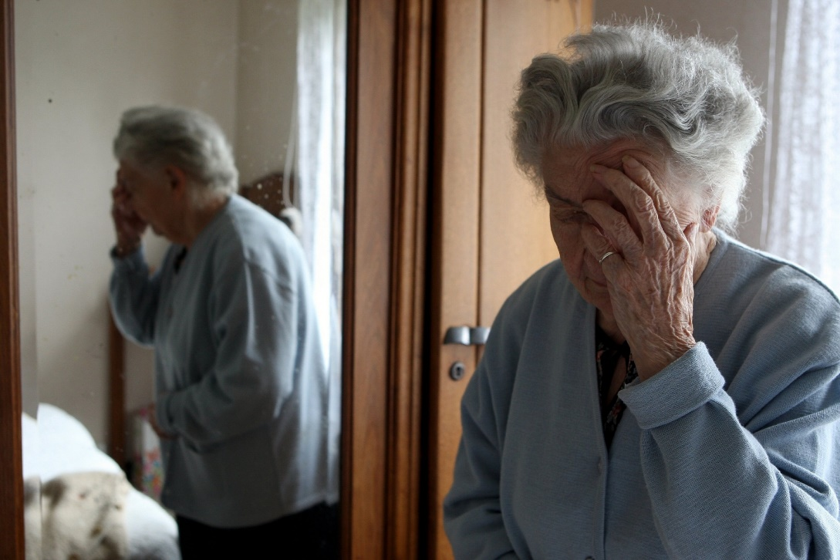
Discussion Breakout
You enter Mrs. Jones apartment and find her looking like this in the morning, what could be some possible reasons and how would you best approach her?
Notes:
Let’s take a few minutes for a situational discussion breakout.
For this situation imagine that you are a care assistant for Mrs. Jones. She lives in an Assisted Living Community and you go into her apartment to check on her one morning and find her looking like this.
Take a minute to assess the environment as well as Mrs. Jones’ nonverbal communication. Using your one-minute assessment how would you best approach her to provide care and support?
Pause the presentation and then start it back up when you are ready to continue.

Slide 18
Summary
Knowing the person with dementia helps staff be person-centered
Using person-centered values and principles also helps staff “get to know” the person!
  One-minutes assessment to gauge next steps
  Best-practices communication with the person
  Engagement in conversation, care, activities
  Trial and error care approaches to learn what “FITS”
  Sharing information with team members
Working in partnership with family
Notes:
There is no doubt that the best way to provide person-centered care is to know the person over time, and use their long-standing values, preferences, characteristics, and experiences to guide daily care.
However, staff caregivers can use the values and principles of person-centered care to “get to know” the person. There are many care situations in which staff don’t know the person YET – and are still building their base knowledge about the person’s history and characteristics.
In those cases, staff can use one-minute assessments to gauge next steps in care, use best-practices in communication, and engage the person in conversations, care routines, and meaningful activities.
Using a “trial and error” approach can help staff learn how MUCH assistance is needed for the person to be successful, and all this together helps staff “get to know” the person so it can be shared with others.
And last but definitely not least, working in partnership with family members is the very best way to stay person-centered in care.

Slide 19
Coming up next
Knowing The Person with Dementia
  Unique and specific ways to develop life stories
  Using life stories to stay person-centered
Notes:
In the next presentation, Knowing the Person with Dementia, we will review both traditional and novel ways that staff and family members may collaborate to develop life stories for the person with dementia.
This rich history can often help care providers both understand behavior AND engage the person in meaningful activities that are essential to high quality care.

