Slide 1


Dentistry and Dementia
MODULE 16
U.S. Department of Health and Human Services
Health Resources and Services Administration
January 2019
The U.S. Department of Health and Human Services, Health Resources and Services Administration developed this module under a contract. Some of the views expressed in this presentation module are solely the opinions of the author(s) and do not necessarily reflect the official policies of the U.S. Department of Health and Human Services or the Health Resources and Services Administration, nor does mention of the department or agency names imply endorsement by the U.S. Government.

Slide 2
Copyright Language
We purchased the images for Modules 1-12 from iStock by Getty.
We accessed the images for Modules 13-16 using Google Find Free-to-Use Images.

Slide 3
Outline
Oral implications of systemic disease
Antibiotic prophylaxis prior to dental care
Oral impact of medications
Preparation for entering the mouth
Oral diseases common to older adults
Assisting with oral hygiene
Salivary Flow
Periodontal Disease
Denture Care for Persons Living with Dementia
Early Intervention

Slide 4
Learning Objectives
By the end of this module, participants will be able to:
Describe the impact that oral health can have on systemic health of persons living with dementia (PLwD);
Describe the impact that oral health can have on the quality of life of persons living with dementia (PLwD);
Describe medical complexities that may have an impact on the ability of PLwD to receive dental care;
Identify clinically significant oral health changes often observed in PLwD and make appropriate referrals; and
Discuss oral health care maintenance strategies with PLwD and their care partners.

Slide 5
Key Take-Home Messages
Dental disease in persons living with dementia (PLwD) can cause challenging behaviors exacerbated by communication challenges.
Members of the health care team should become familiar with common oral health concerns.
Dental care for PLwD is complicated by the many challenges of the disease and comorbid conditions.
Early intervention and thorough daily hygiene are essential components of care.

Slide 6
Case Report
An 85-year-old person in the advanced stages of Alzheimer's disease developed new challenging behaviors
  Biting and hitting care-providers
  Biting cutlery
  Weight loss
  Biting his own hand
  Spitting
  (Inaba et al, 2011)

Slide 7
Case Report (continued)
No improvement until dental examination despite repeated physical exams/medication
Extraction of three carious teeth (under general anesthesia)
Antisocial behaviors (hitting, biting, and spitting) ended.
(Inaba et al, 2011)

Slide 8
Quality of Life
Reported Difficulty | Dentulous (Natural teeth present in oral cavity) | Edentulous (Toothlessness)
Eating | 29.1% | 16.9%
Speaking | 6.5% | 16.4%
Smiling/ Laughing | 4.0% | 9.1%
Social Exchange | 3.2% | 3.6%
Toothache in past 6 months | 17.7% | NA
Porter, 2015

Slide 9
Quality of Life (continued)
Subjectively Reported Oral Problems | Dentulous | Edentulous
At least one problem | 61.3% | 50.9%
Loose or ill-fitting dentures | 4.3% | 4.3%
Dry Mouth | 41.2% | 40.0%
Social Exchange | 3.2% | 3.6%
Toothache in past 6 months | 17.7% | NA
Broken Teeth | 23.9% | NA
Sensitivity | 15.4% | NA

Slide 10
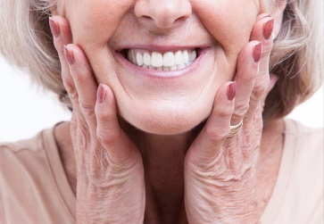
Oral Health
Oral health care takes place within the context of the whole body.
Oral health affects systemic health, and systemic health affects oral health.
Dental care needs to be holistic in approach.

Slide 11
Outline 2 - Oral implications of systemic disease
Oral implications of systemic disease
Antibiotic prophylaxis prior to dental care
Oral impact of medications
Preparation for entering the mouth
Oral diseases common to older adults
Assisting with oral hygiene
Salivary Flow
Periodontal Disease
Denture Care for Persons Living with Dementia
Early Intervention
Notes:
Talking Points:
We will start by discussing the oral implications of systemic disease in persons living with dementia, many of whom are older adults and may be experiencing several comorbidities.

Slide 12
Impact of Systemic Disease on Oral Care - 1
Persons living with dementia may:
  Have one or more additional chronic diseases.
  Experience impaired access to regular dental assessment and care.
  No longer practice, or adequately practice, their own daily oral care.
  Be unable or fail to communicate symptoms of incipient oral disease.

Slide 13
Impact of Systemic Disease on Oral Care - 2
Dental personnel often contact primary care teams, seeking medical clearance and/or guidance regarding dental care for PLwD who have, or are at risk for:
  Aspiration pneumonia;
  Diabetes mellitus;
  Anticoagulation regimen;
  History of irradiation of the head and neck;
  History of administration of bisphosphonate;
  Requiring antibiotic prophylaxis prior to dental care; or
  Medications with adverse oral side effects.

Slide 14
Aspiration Pneumonia
Mouth and pharynx are in the airway and are coated by excretions with 10¹²-10¹⁴ microorganisms/cc.
Oral cavity and throat become rapidly populated by organisms in the health care setting, many of which will be multi-drug resistant.
Gram negative anaerobes populating the gums (gingiva) are the most common pathogens in facility-acquired pneumonia.
Incidence of facility-acquired pneumonia can be reduced through a program of regular oral hygiene, including once-daily tooth- and denture-brushing and antimicrobial mouth rinse.

Slide 15
Diabetes and Oral Health
Periodontitis, a chronic inflammatory bacterial infection of the tissues surrounding teeth, is highly prevalent in adults of advanced age, particularly those with inadequate daily oral care.
The chronic inflammation of periodontitis, like other inflammatory processes, interferes with glycemic control.
In turn, impaired glycemic control results in an exacerbated inflammatory response to the local factors responsible for periodontitis and gingivitis.
Daily provision of oral hygiene—which may be beyond the ability of the PLwD, and which then becomes a care partner’s responsibility—can interrupt this pernicious cycle.
Diabetic PLwD who undergo extensive dental care (particularly oral surgery, e.g., extractions) are likely to miss one or more meals. They and their care partners may need to be counseled to adjust the insulin regimen on the day of care.

Slide 16
Anticoagulation
The mouth is highly vascularized and prone to hemorrhage following mucosal trauma if coagulation is suppressed.
It is extremely common to see anticoagulation regimens in PLwD (particularly multi-infarct dementia), as part of managing atrial fibrillation, deep venous thrombosis, and elevated stroke risk.
In such persons, the risk of thrombosis due to a disruption in the anticoagulation regimen far outweighs the hemorrhagic risk of oral trauma.
If international normalized ration (INR) is 4 or less, dental care does not require adjustment of anticoagulation regimen as long as it is augmented as necessary with local measures (e.g., limit number of extractions in a single sitting; gelatin sponge/primary closure)

Slide 17
Head and Neck Irradiation
PLwD about to undergo treatment for squamous cell cancer of the mouth or oropharynx MUST have a pre-procedural dental assessment and extraction of teeth at elevated risk for caries BEFORE irradiation therapy commences.
After treatment, intense dental follow-up for maintenance of the teeth is essential to prevent the subsequent need for extractions.

Slide 18
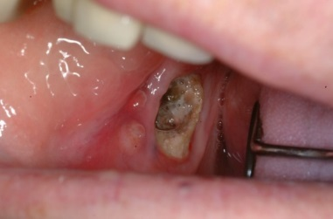
Bisphosphonates
Intravenous administration of bisphosphonates (BP) for management of multiple myeloma or prevention of osteoporosis has been linked to a small (<5%) but definite risk for osteonecrosis following intraoral trauma.
Prevention of osteonecrosis is far more successful than treatment, particularly for PLwD.
Individuals scheduled for Intravenous (IV) BP treatment should undergo a dental assessment so necessary extractions and bone healing occur before administration of BP.

Slide 19
Outline 3 - Antibiotic prophylaxis prior to dental care
Oral implications of systemic disease
Antibiotic prophylaxis prior to dental care
Oral impact of medications
Preparation for entering the mouth
Oral diseases common to older adults
Assisting with oral hygiene
Salivary Flow
Periodontal Disease
Denture Care for Persons Living with Dementia
Early Intervention

Slide 20
Antibiotic Prophylaxis Prior to Dental Care? - The Issue
As noted earlier, the oral cavity is highly vascular and densely populated with microorganisms.
This predisposes to frequent transient bacteremias in adults with teeth.
Thorough daily oral hygiene and regular dental care is vital to reducing the risk of serious infections, particularly in persons at elevated risk.

Slide 21
Antibiotic Prophylaxis Prior to Dental Care – The Guidance
The risks of widespread prophylactic administration of broad spectrum antibiotics prior to dental care far outweigh the benefits of coverage in most cases.
There are no compelling population-based data supporting the prophylactic administration of antibiotic prior to dental care for patients with other “devices.”

Slide 22
Outline 4 - Oral impact of medications
Oral implications of systemic disease
Antibiotic prophylaxis prior to dental care
Oral impact of medications
Preparation for entering the mouth
Oral diseases common to older adults
Assisting with oral hygiene
Salivary Flow
Periodontal Disease
Denture Care for Persons Living with Dementia
Early Intervention

Slide 23
Oral Impact of Medications
Dry mouth (xerostomia) is a common medication side effect, reported for a broad range of agents.
Typically results from changes in saliva’s quantity or quality (e.g., electrolytic, antimicrobial, mucinous content)
Saliva is a critically important exocrine fluid.
Salivary modification, particularly its absence, can:
  Accelerate tooth decay
  Increase susceptibility to oral mucosal trauma/infection
  Exacerbate predisposition to infectious pulmonary disease

Slide 24
Oral Assessment
Two critical roles for care providers are to:
  Assess the oral health status of PLwD and make appropriate referrals
  Provide education for persons living with dementia and their care partners regarding oral health maintenance and strategies for supporting oral health
To build the foundation for both, the steps for completing a quick but thorough assessment of oral health follow. The assessment begins outside the mouth with observation of the skin of the face, scalp, and neck for changes and observation and palpation of nodes.

Slide 25
Outline 5 - Preparation for entering the mouth
Oral implications of systemic disease
Antibiotic prophylaxis prior to dental care
Oral impact of medications
Preparation for entering the mouth
Oral diseases common to older adults
Assisting with oral hygiene
Salivary Flow
Periodontal Disease
Denture Care for Persons Living with Dementia
Early Intervention

Slide 26
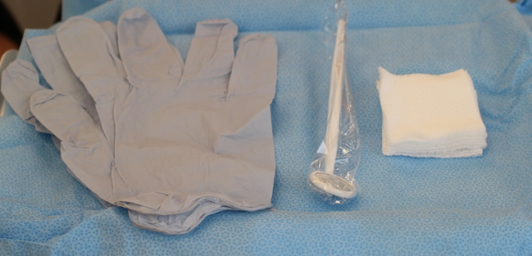
Preparation for Entering the Mouth
Set up the following:
  Light source
  Disposable sterile mouth mirrors
    Available at low cost
    Tongue blades work but not as well
  2x2 gauze
  Gloves

Slide 27
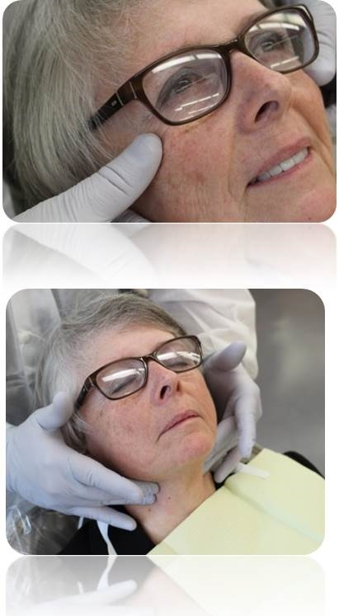
Oral Assessment: Skin of Face, Scalp, and Neck, Nodes of the Head and Neck
Extra-oral examination
  Observe first
  Then palpate
Assess or evaluate following:
  Color
  Contour
  Consistency
  Function
  Symmetry
  Texture

Slide 28
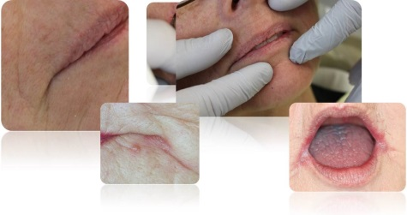
Oral Assessment: Lips and Labial Mucosa (Inside Lining of the Lips)
Color
Contour
Consistency
Function
Symmetry
Texture

Slide 29
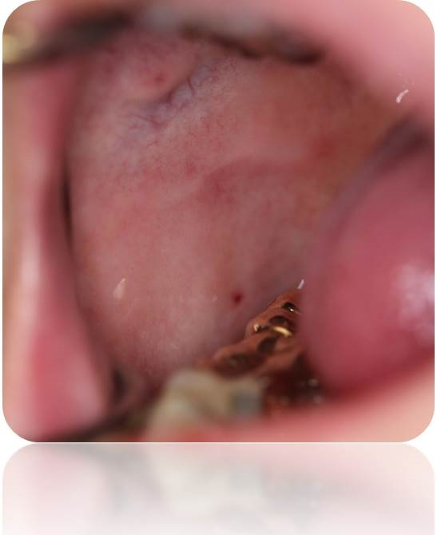
Oral Assessment: Buccal (Cheek) Mucosa
Color
Contour
Consistency
Function
Symmetry
Texture

Slide 30
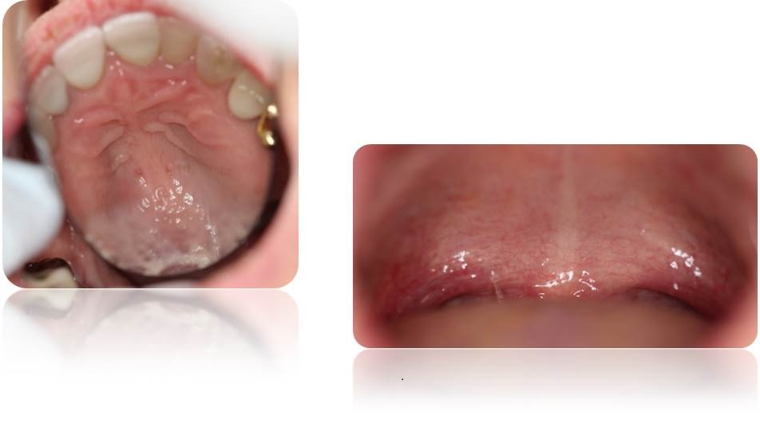
Oral Assessment Hard and Soft Palate Oropharynx
Color
Contour
Consistency
Function
Symmetry
Texture

Slide 31
Oral Assessment: Tongue
Have person extend the tongue.
Grasp with 2x2 gauze and stretch out for visualization
Lateral border of the tongue is the most common site for oral cancer
Take pictures and slides to document

Slide 32
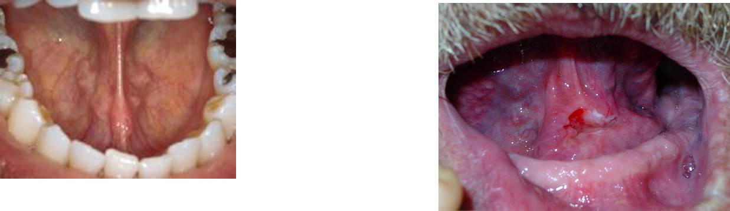
Oral Assessment: Floor of the Mouth
The Second most common site for oral cancer
Color
Contour
Consistency
Function
Symmetry
Texture

Slide 33
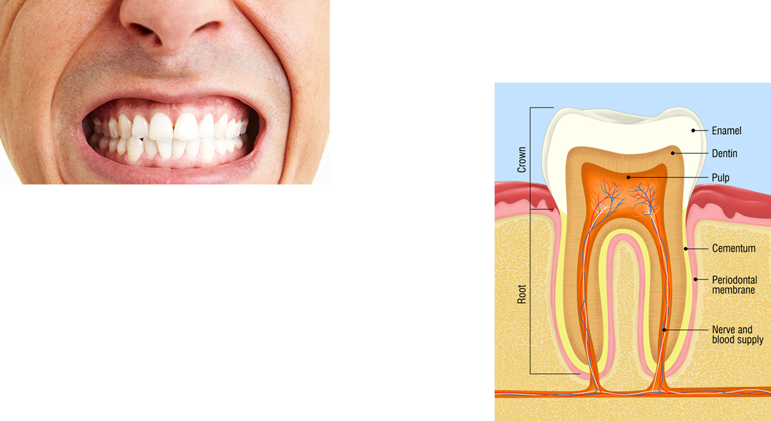
Oral Assessment: Teeth and Supporting Structures
Color
Contour
Consistency
Function
Symmetry
Texture

Slide 34
Outline 6 - Oral diseases common to older adults
Oral implications of systemic disease
Antibiotic prophylaxis prior to dental care
Oral impact of medications
Preparation for entering the mouth
Oral diseases common to older adults
Assisting with oral hygiene
Salivary Flow
Periodontal Disease
Denture Care for Persons Living with Dementia
Early Intervention

Slide 35
Oral Diseases Common to Older Adults
Caries (tooth decay)
Periodontal disease (diseases of the supporting structures for the teeth)
Edentulism (loss of teeth)
Oral Cancer

Slide 36
Caries
Dental caries is a transmissible microbial disease that results in the dissolution of the calcified tooth structure of the crown or the root of the tooth, which can progress into the tooth, creating a cavitation that can be observed clinically or radiographically, and eventually into the dental pulp.

Slide 37
Caries Epidemiology
Yearly incidence of new caries lesions in nursing home residents (Chalmers et al., 2005)
  Coronal caries = 64.4%
  Root caries = 48.5%
  Significantly higher than community-dwelling older adults (Chalmers et al., 2002)
3 times the rate of caries compared with a similar cohort (Finland) (Syrjälä, et al., 2012)
Mean number of teeth with caries (North Carolina) (Chen, et al., 2013) ⁴
  6.0 (nursing home residents)
  5.5 (community-dwelling)
  5.3 (assisted living)
Among PLwD subjects, 89% had at least one caries lesion (Denmark) (Ellefsen, et al., 2012)

Slide 38
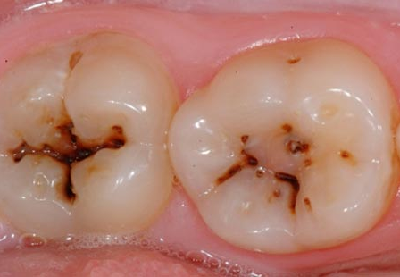
Caries Location
The surfaces of teeth, whether enamel on the crowns of teeth or exposed cementum on roots, undergo a constant dynamic mineral exchange with the oral environment.

Slide 39
Caries Development
Carries occur when the microorganisms in the plaque that colonizes the teeth metabolize carbohydrates and produce acids that demineralize the tooth structure to a greater degree than the calcium in saliva can re-mineralize the tooth.

Slide 40
Caries Risk is Increased in the Presence of:
Undisturbed plaque (biofilm)
Frequent exposure to fermentable carbohydrates (diet)
Reduced salivary flow (host factor)
Teeth with low fluoride exposure (host factor)
Exposed roots
(less densely mineralized
tooth structure)

Slide 41
Caries Risk in Persons Living with Dementia
Undisturbed plaque
  Higher in persons with dementia (Foltyn, 2015)
Frequent exposure to fermentable carbohydrates
  Commonly available in long term care settings
  May be used as “comfort”
Reduced salivary flow is most commonly associated with medications
  Mean number of drugs = 7.1 (Foltyn, 2015)
Teeth with low fluoride exposure
  Depends on community water fluoridation
  May be supplemented by care partners/care providers
Exposed roots

Slide 42
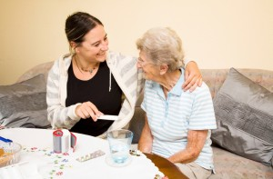
Plaque Biofilm Reduction
Tooth brushing
  Electric brushes and water flossing devices may help if tolerated
  Collis-curve brush attempts to cover more surface area in less time
  Adaptations to brushes may need to be made

Slide 43
Outline 7 - Assisting with oral hygiene
Oral implications of systemic disease
Antibiotic prophylaxis prior to dental care
Oral impact of medications
Preparation for entering the mouth
Oral diseases common to older adults
Assisting with oral hygiene
Salivary Flow
Periodontal Disease
Denture Care for Persons Living with Dementia
Early Intervention

Slide 44
Assisting with Oral Hygiene
Technique will vary depending on the ability of the person to cooperate
Brushing: Stand behind the person living with dementia and either support the person’s head with the non-dominant hand or rest it firmly on the shoulder on the side to be brushed to divert the attention of the person

Slide 45
Brushing
Place a soft-bristled brush (manual or electric) at a 45 degree angle to the teeth with the bristles pointing into the gingival tissue and vibrate or create small circle. Then move to the next site.
If this level of brushing is simply not allowed by the person living with dementia, aids like the Collis-Curve brush may help to cover more tooth surface with each attempt.

Slide 46
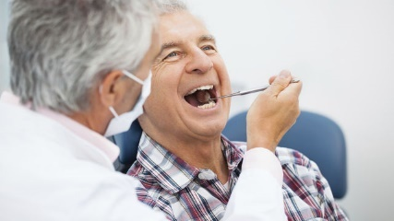
Cleaning Between the Teeth
Although floss is the gold standard, anything that safely cleans between the teeth is encouraged.
  Flossing is most easily accomplished from the front of the person living with dementia.
  A flossing device will protect the care provider from risk of biting.
  Many other devices for interproximal cleaning are commercially available and may be easier to manage than floss (e.g., water flossing device).

Slide 47
Fluoride
Facilitates remineralization (reversal) of incipient caries lesions
Renders tooth mineral more resistant to dissolution in bacterially-excreted acid
Impairs bacterial metabolism of carbohydrate into acid
Three major forms of topical fluoride available:
  NaF: Sodium Fluoride
  SnF₂: Tin Fluoride, which has the added benefit of suppressing periodontal pathogens
  Silver diamine fluoride

Slide 48
Delivery of Fluoride
Community water supplies
  Available in some communities since 1949
Over the counter dentifrice/mouthwash
  Little evidence to support efficacy in high risk patients
  Readily available
Professionally-applied and –prescribed preparations (higher concentration gel, varnish)

Slide 49
Sources of Fluoride Effective for Reducing Caries Risk
1.1% neutral sodium fluoride dentifrice or gel
  Prescription required
  Recommended by the American Dental Association for use twice daily (Weyant et al., 2013)
2.26% fluoride varnish
  Professionally applied
  Recommended by the American Dental Association for application every 3-6 months (Weyant et al., 2013).
  For persons at high risk for caries, recommended applications every 3 months (Young & Featherstone, 2013)
38% silver diamine fluoride (Rosenblatt, Stamford & Niederman, 2009)
  Professionally applied 1-2 times/year

Slide 50
Case Presentation
The patient was a World War II veteran who had been a prisoner of war in the Philippines. He had been treated in a VA Dental Clinic for many years and maintained an intact dentition. Declining cognitive function led to residence in a nursing facility. When he came to dental appointments, his teeth were completely covered with plaque, and he began developing caries at an alarming rate.
Efforts at encouraging the facility to provide more support for oral hygiene were unsuccessful. In response to the needs of this veteran, the staff at the dental clinic looked for a solution and decided to bring him into the clinic once a month, and an auxiliary staff member would brush his teeth and apply fluoride varnish.
The strategy effectively decreased the rate of new caries for this veteran, and he maintained a functioning dentition until his death. As a result of this outcome, the clinic established a program to provide this service for veterans who could no longer maintain oral health. The tooth brushing does not require the skills of a dental professional, and the application of fluoride varnish is legal in many states in other health care settings.

Slide 51
Outline 8 - Salivary Flow
Oral implications of systemic disease
Antibiotic prophylaxis prior to dental care
Oral impact of medications
Preparation for entering the mouth
Oral diseases common to older adults
Assisting with oral hygiene
Salivary Flow
Periodontal Disease
Denture Care for Persons Living with Dementia
Early Intervention

Slide 52
Salivary Flow
Functions of saliva
  Maintenance of tooth integrity (ions for remineralization)
  Initiation of digestion
  Lubrication of tissues
  Mastication and bolus formation
  Buffering
  Antibacterial, antiviral, antifungal activity
Causes of xerostomia or salivary hypofunction
  Medications
  Autoimmune diseases
  Radiation
  Salivary gland infection, obstruction, tumor, excision
  Fluid and electrolyte problems

Slide 53
Management of Xerostomia/Salivary Hypofunction
As a complex bodily fluid that supports the health of the dentition and oral mucosa as well as initiating digestion, salivary stimulation, when physiologically feasible, is the most effective management tool.
Salivary replacement provides comfort in eating, speaking and swallowing.
Protecting the teeth with effective oral hygiene measures and use of agents such as fluoride mitigates some of the increased risk associated with a dry mouth.

Slide 54
Salivary Stimulation
Sugarless gum and candy
  Sweetened with polyols (e.g., xylitol, sorbitol)
    Replace fermentable carbohydrates with sweeteners of low cariogenicity
    May have a direct anti-plaque effect
Prescription sialagogues ( drugs or substances that increases the flow rate of salavia)
  Pilocarpine hydrochloride
    Head and neck cancer/Sjogren’s syndrome
    5-10 mg 3-4 times per day not to exceed 30 mg
    Titrated to lowest effective dose
  Cevimeline
    Sjogren’s syndrome
    30 mg tid (3 times daily)

Slide 55
Salivary Replacement
Water
  A cup with a lid filled with ice and water is convenient.
  Sugared beverages greatly increase the risk of oral diseases; artificial sweeteners are less worrisome.
Artificial saliva, mouthwashes
  Several manufacturers market products for persons with salivary hypofunction.
  The products may support speech, swallowing, and oral comfort by providing oral lubrication.
  The products do not possess the disease-suppression or disease-reversal properties of natural saliva.

Slide 56
Diet
Reduce frequency of intake of fermentable carbohydrates
Replace with foods rich in proteins

Slide 57
Outline 9 - Periodontal Disease
Oral implications of systemic disease
Antibiotic prophylaxis prior to dental care
Oral impact of medications
Preparation for entering the mouth
Oral diseases common to older adults
Assisting with oral hygiene
Salivary Flow
Periodontal Disease
Denture Care for Persons Living with Dementia
Early Intervention
Notes:
Talking Points:
We will next cover periodontal disease and care of the periodontium.

Slide 58
Periodontal Disease
Diseases of the periodontium (supporting structures of the teeth) arise in response to pathogenic microorganisms in dental plaque.
The initial soft tissue reaction to plaque is gingival inflammation with redness and bleeding (“gingivitis”). This can be resolved by thorough cleaning of tooth surfaces.
A variable blend of host and microbial factors may trigger the release of destructive inflammatory factors that irreversibly destroy hard and soft tissues surrounding affected teeth (“periodontitis”).
In the advanced stages of periodontitis disease, the teeth become mobile and may eventually be lost, impairing mastication.

Slide 59
Periodontal Disease (continued)
Advanced periodontal disease is more common with advanced age because of the tissue loss over the life span.
Diminished or absent oral self-care of PLwD places them at elevated risk for gingival and periodontal diseases (Zenthöfer, et al., 2014), and makes it imperative that daily oral hygiene is faithfully and effectively provided by care partners.

Slide 60
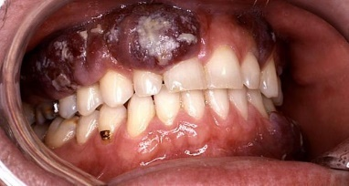
Oral Cancer
Over 45,000 new cases per year in US, mostly in individuals age 50 and over; male preponderance
Associated with tobacco/heavy alcohol use and human papilloma virus
Most common sites: base and lateral border of the tongue and floor of the mouth
Red and mixed red/white lesions far more concerning, mandating immediate evaluation by an oral health professional
White lesions less likely malignant. Potential causes (e.g., trauma from fractured tooth, denture irritation, etc.) should be addressed and the lesion re-evaluated in 7-14 days. If it persists, referral for professional assessment should occur.
Generally favorable prognosis when disease is localized; lymphatic or metastatic involvement substantially worsens morbidity and mortality
(NCI Statistics Fact Sheets)

Slide 61
Edentulousness--Toothlessness
Thanks to fluoridated drinking water, fluoride-containing toothpaste, and increased access to dental care, less than 25% of Americans aged 75 and over experience toothlessness.
Toothlessness is most prevalent in rural areas, southeastern states, and among people who are less educated, socio-demographically disadvantaged, or immigrants.
Incidence is likely greater in PLwD due to impaired self-care and the likelihood for dental professionals to opt for extracting diseased teeth.

Slide 62
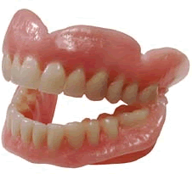
Toothlessness and Dentures
Edentulousness is not clearly correlated with suboptimal nutritional intake.
Dentures may anecdotally lead to improved dietary intake.
Dentures restore the appearance of teeth and fill out the lips and lower face; improve the clarity of speech; and may result in an expanded range of foods’ textures.
Once teeth have been removed, the alveolar processes diminish in volume at a variable rate over the ensuing years.
Use of dentures requires a level of tolerance, learning, and orofacial neuromuscular proprioception and control that PLwD may not adequately possess.

Slide 63
Outline 10 - Denture Care for Persons Living with Dementia
Oral implications of systemic disease
Antibiotic prophylaxis prior to dental care
Oral impact of medications
Preparation for entering the mouth
Oral diseases common to older adults
Assisting with oral hygiene
Salivary Flow
Periodontal Disease
Denture Care for Persons Living with Dementia
Early Intervention

Slide 64
Denture Care for Persons Living with Dementia
Dentures, like teeth, are populated with adherent microbial colonies. Unlike teeth, dentures support yeast colonies.
Brush dentures at least daily.
Leave dentures out of the mouth part of each day.
Store dentures in clean water or denture soaking solution.
For safety reasons, PLwD should not have access to dentures stored in soaking solution.

Slide 65
Dentures in Congregate Settings
Every denture is individually fabricated to fit one person’s mouth, but to the untrained eye, they look alike.
For this reason, people who reside in or attend settings largely populated by persons of advanced age and those living with dementia should have labels placed on their dentures.
Clear labeling will reduce the risk of losing dentures.

Slide 66
Oral Health and Adults with Intellectual Disability
Adults with Down syndrome are at significantly increased risk for the development of dementia as they age and may have poor oral health practices.
Craniofacial and dental anomalies are common features of many genetic diagnoses. These anomalies may lead to increased incidence and/or severity of dental caries and periodontal disease. Some adults with intellectual disability may not tolerate prosthetic replacement of teeth or dentures.
Persons with intellectual disability may have a far longer history of poor diet and oral care than other adults; this must be factored in to the current dental and medical care plan.
In addition to cognitive decline associated with dementia, adults with intellectual disability present with a cognitive disability that can impair attempts at dental examination and treatment.

Slide 67
Dental Treatment Options
Factors to consider:
  Early intervention
  Access and finance
  Quality of life
  Challenging behaviors
  Realistic expectations

Slide 68
Outline 11 - Early Intervention
Oral implications of systemic disease
Antibiotic prophylaxis prior to dental care
Oral impact of medications
Preparation for entering the mouth
Oral diseases common to older adults
Assisting with oral hygiene
Salivary Flow
Periodontal Disease
Denture Care for Persons Living with Dementia
Early Intervention

Slide 69
Early Intervention
Dementia diminishes the capacity of PLwD for treatment decision-making, self-care, and impulse suppression over time.
Identify PLwD’s priorities and preferences as early as possible.
Dental care requiring more patient cooperation, learning, and adaptation becomes increasingly challenging over time.
Daily oral care behaviors should begin as soon as possible but do not guarantee that PLwD's tolerance and cooperation will be sustained.

Slide 70
Access and Finance
Dental care can be prohibitively costly for a person or family on a fixed budget.
Financial barriers may limit care options (e.g, prevention, extractions, and fillings).
Most dental offices have limited capacity to accommodate persons in wheelchairs, adults with aversive behaviors or who require conscious sedation.
PLwD may require dental care in the home, in a long-term care facility, or with anesthesia in a hospital setting.

Slide 71
Behavioral Issues in the Dental Setting
PLwD may tolerate dental care in a typical office setting.
PLwD may also react negatively to an unfamiliar setting.
Dental personnel with advanced training may be able to manage PLwD through verbal and non-verbal techniques to facilitate routine dental care.
Administration of low-dosage oral benzodiazepine may facilitate cooperation during dental care (in consultation with primary care team).
Nitrous oxide administration may not be tolerated due to the apparatus placed over the nose.
With persons living with dementia and intellectual disability, it is often helpful to have a staff or family member accompany them into the setting on the dental care visit.

Slide 72
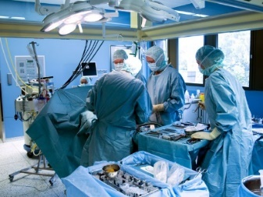
Realistic Expectations
Most prosthetic tooth replacements will require a greater commitment to technically challenging daily oral care for the lifetime of the prosthesis than does the natural dentition.
The exception to the preceding generalization is removable dentures that replace all the teeth, and can be removed from the mouth for cleaning.
If PLwD’s reaction to receiving dental care is so severe that it requires sedation or general anesthesia, treatment must usually be limited to removal of all or at least diseased teeth and prophylaxis (cleaning).
Care partners and family member should be educated about how to assist with the cleaning.

Slide 73
Quality of Life
Pain from dental and oral disease can overwhelm all other conscious experience, represent a potentially life-threatening infection, disrupt oral intake, complicate management of other chronic disease conditions, and/or result in challenging behaviors.
Untreated dental and oral disease can impede socialization.
Reduction in number of teeth is correlated with a diminishing range of tolerable foods and reduced pleasure from eating for PLwD.

Slide 74
Evaluation
Health professionals in addition to those in the dental field should acquire and maintain familiarity with the appearance of the normal structures of the oral cavity of persons living with dementia
In order to be able to discern the presence of something that is potentially abnormal
Because access to dental care for such individuals is more likely to be compromised than access to medical or nursing care
Because the mouth is a part of the body intimately associated with nutrition, respiration, communication, and socialization.
All of the above
Dental caries forms as a result of
Microorganisms adhering to tooth structure and metabolizing dietary carbohydrate into organic acids
Decalcification of tooth structure by organic acids
Remineralization by saliva of decalcified areas of tooth structure to a lesser degree than the decalcification progresses
All of the above

Slide 75
Evaluation (continued)
Toothlessness in a person living with dementia
Cannot be managed with dentures, because the cognitive impairment that accompanies dementing illness makes it impossible for the individual to accommodate to the prostheses
Is less common today than it was during the twentieth century because the prevalence of total tooth loss at all ages has been steadily dropping in industrialized countries
Is the most reasonable solution to nearly all dental conditions, because once the individual no longer has teeth, there is no longer a need for daily oral hygiene or periodic dental care
Is an indication for full-mouth dental implants, because they can be placed in a single visit to the dentist, are readily affordable, and can’t decay and therefore require no daily cleaning.
Transient bacteremia of oral origin in a person living with dementia
Is a common occurrence due to the highly vascular nature of the oral cavity, the large number of microorganisms present, and the common occurrence of intraoral infections such as gingivitis and periodontitis due to compromised oral hygiene.
Is generally not caused by dental care or oral surgery because of the sterile field and careful technique employed in dental offices
May cause metastatic infection on cardiac valves scarred by endocarditis or replaced with implants, unless the patient has been preoperatively treated with ticlopidine to prevent bacteria from adhering to at-risk tissues
Is a concern in all joint prostheses, regardless of how long the appliance has been in place.

Slide 76
Acknowledgements
This module was prepared for the U.S. Department of Health and Human Services (HHS), Health Resources and Services Administration (HRSA), by The Bizzell Group, Inc., under contract number HHSH25034002T/HHSH250201400075I.
The dementia and education experts who served on the Dementia Expert Workgroup to guide the development of the modules included: Alice Bonner, PhD, RN, FAAN, Secretary Elder Affairs, Massachusetts Executive Office of Elder Affairs, Boston MA; Laurel Coleman, MD, FACP, Kauai Medical Clinic -Hawaii Pacific Health, Lihue, HI; Cyndy B. Cordell, MBA, Director, Healthcare Professional Services, Alzheimer's Association, Chicago, IL; Dolores Gallagher Thompson, PhD, ABPP, Professor of Research, Department of Psychiatry and Behavioral Sciences, Stanford University School of Medicine, Stanford, CA; James Galvin, MD, MPH, Professor of Clinical Biomedical Science and Associate Dean for Clinical Research, Florida Atlantic University, Boca Raton, FL; Mary Guerriero Austrom, PhD, Wesley P Martin Professor of Alzheimer's Disease Education, Department of Psychiatry, Associate Dean for Diversity Affairs, Indiana University-Purdue University Indianapolis, Indianapolis, IN; Robert Kane, MD, Professor and Minnesota Chair in Long-term Care & Aging, Health Policy & Management, School of Public Health, University of Minnesota; Jason Karlawish, MD, Professor of Medicine, Perelman School of Medicine, University of Pennsylvania; Helen M. Matheny, MS, APR, Director of the Alzheimer's Disease Outreach Program, Blanchette Rockefeller Neuroscience Institute, Morgantown, WV; Darby Morhardt, PhD, LCSW, Associate Professor, Cognitive Neurology and Alzheimer's Disease Center and Department of Preventive Medicine, Northwestern University Feinberg School of Medicine, Northwestern University, Chicago, IL; Cecilia Rokusek, EdD, MSc, RDN, Assistant Dean of Research and Innovation, Professor of Family Medicine, Public Health, Nutrition, and Disaster and Emergency Preparedness, College of Osteopathic Medicine, Nova Southeastern University, Fort Lauderdale, FL. Additional expertise in the development of the modules was provided by Meg Kabat, LCSW-C, CCM; Eleanor S. McConnell, PhD, MSN, RN, GCNS, BC; Linda O. Nichols, PhD, MA, BA; Todd Semla, MS, PharmD, BCPS, FCCP, AGSF; Kenneth Shay, DDS, MS, from the U.S. Department of Veterans Affairs and Lea Erickson, DDS, MSPH, Associate Professor, School of Dentistry, University of Utah, Salt Lake City, Utah; Seth Keller, MD and Matt Janicki, PhD, National Task Group on Intellectual Disabilities and Dementia Practices.

Slide 77
Brought to you by the
U.S. Department of Health and Human Services,
Health Resources and Services Administration

