Slide 1



Ethics and Capacity Issues
MODULE 11
U.S. Department of Health and Human Services
Health Resources and Services Administration
December 2018
The U.S. Department of Health and Human Services, Health Resources and Services Administration developed this module under a contract. Some of the views expressed in this presentation module are solely the opinions of the author(s) and do not necessarily reflect the official policies of the U.S. Department of Health and Human Services or the Health Resources and Services Administration, nor does mention of the department or agency names imply endorsement by the U.S. Government.

Slide 2
Copyright Language
We purchased the images for Modules 1-12 from istock by Getty.
We accessed the images for Modules 13-16 using Google Find Free-to-Use Images.

Slide 3

Photo – Man talking to senior couple

Slide 4

Outline
Overview
Legal and financial considerations
Capacity considerations
Ethical considerations
Elder abuse

Slide 5
Learning Objectives
After reviewing this module, the learner will be able to:
List legal and financial considerations to discuss with a patient and appropriate care partner(s) upon a diagnosis of dementia.
Identify domains that are included in a capacity assessment for a person living with dementia.
Identify ethical issues related to participation in dementia research.
Recognize signs of elder abuse.

Slide 6
Key Take-Home Messages
Have a high level of suspicion for elder abuse or neglect.
Do not underestimate the ability of PLwD to express opinions about their care.
Older people have the right to take informed risks.
Primary care providers (PCPs) have an important role in determining a person’s decision-making capacity.

Slide 7

Photo – Senior man leading business meeting

Slide 8

Outline
Overview
Legal and financial considerations
Capacity considerations
Ethical considerations
Elder abuse

Slide 9
Overview
Person living with dementia (PLwD), care partner(s), and families face many decisions after receiving a diagnosis
of dementia:
  Legal
  Financial
  Medical
  Ethical

Slide 10
Roles and Responsibilities of Primary and Health Care Providers
Treatment team: Recommend that PLwD and care partners seek professional help to navigate legal and financial decisions.
Primary care providers (PCPs): Assess PLwD for capacity (if appropriate); competence determined by judge (Dastidar & Odden, 2011).
PCPs and other health care providers (HCPs): Have a global understanding of issues facing PLwD and care partners; recommend professional assistance to help address these issues.
PCPs and other HCPs: Recognize signs and symptoms of elder abuse and report accordingly.

Slide 11

Photo – Senior woman with advisor

Slide 12

Outline (2)l Legal and
Overview
Legal and financial considerations
Capacity considerations
Ethical considerations
Elder abuse

Slide 13
Legal and Financial Planning: Overview
Recommend to begin planning for future as soon as possible so PLwD can participate in decision-making process (Fisk et al., 2007; Grossberg et al., 2010).
  Communicate health care wishes.
  Make long-term care arrangements.
  Make plans for finances and property.
Identify “proxy” to take over decision-making when PLwD no longer have capacity to make decisions (Kim et al., 2011).

Slide 14

Photo – Senior couple with advisor

Slide 15
Identifying Nonmedical Professionals for the Dementia Team
Elder law attorney
Accountant and/or financial planner
Geriatric care manager
Other

Slide 16
Financial Burdens Associated With Dementia Diagnosis
Direct costs of medications and doctor visits (for dementia and comorbidities)
Potential future costs (Hurd et al., 2013)
  Future need for home and community-based services
  Safety-related expenses
  Personal care supplies
  Costs associated with assisted living or nursing home care
Costs associated with specialty teams (lawyers, accountants, case manager)
Many PLwD do not have the financial resources to cover these costs.

Slide 17
Financial Considerations: Medicaid
Average costs for long-term care services in U.S. are substantial; many PLwD are unable to afford costs without financial assistance (Genworth, 2015; Alzheimer’s Association, n.d.).
Medicare coverage is for acute, not chronic, needs.
PLwD may need to apply for Medicaid (medical assistance) benefits to cover costs; need to understand state-specific rules (Healthcare.gov, n.d.).

Slide 18

Photo – Couple and young son with advisor

Slide 19
Understanding the Necessary Legal Documents
Standard will
Living trust
Advance medical directive
Living will (Mayo Clinic, 2014)
Durable powers of attorney
Research advance directives (Muthappen et al., 2005)
POLST (physician or provider orders for life-sustaining treatment) or MOLST (medical orders for life-sustaining treatment)

Slide 20
Guardianship
Not a common occurrence
In absence of power of attorney, courts appoint guardian (or conservator) if person no longer capable of making own decisions (Karlawish, 2008)
An alternative to guardianship: supported decision-making
  The PLwD receives help to make decisions
  Supported Decision-Making Pilot Project

Slide 21

Outline (3)
Overview
Legal and financial considerations
Capacity considerations
Ethical considerations
Elder abuse

Slide 22
Capacity: Overview, Issues
Assessment of decision-making capacity is needed when a person living with dementia is required to make decisions involving risks.
Capacity laws differ by state.
Capacity is functional assessment of 4 abilities: understanding, appreciation, expressing a choice, and rationalization (Dastidar & Odden, 2011; Karlawish, 2008; Lai et al., 2008; Woods & Pratt, 2005).

Slide 23
Capacity Considerations in Dementia
PCPs are able to make clinical determinations of capacity (Dastidar & Odden, 2011; Karlawish, 2008).
  Competency is a legal determination (Dastidar & Odden, 2011).
Memory impairments may influence capacity, which is not static (Mitty, 2009).
PLwD who lack insight have impaired decision-making capacity (Cosentino et al., 2011).
Consider capacity to receive a diagnosis (Dastidar & Odden, 2011), and document if PLwD lack capacity (Grossberg et al., 2010).

Slide 24
When To Assess Capacity
Assess for capacity if any provider or care partner questions the PLwD’s decision-making capacity.
Send for formal assessment by a psychologist or a psychiatrist if capacity is not clear.
Talk to the PLwD about capacity issues during the course of the illness.

Slide 25
Tools to Assess for Medical Decision-Making Capacity
Numerous clinical tools can be used to assess medical decision-making capacity (Dastidar & Odden, 2011):
  McArthur Competence Assessment Tools for Treatment (MacCAT-T) (Grisso et al., 1997)
  Capacity toC onsent to Treatment Instrument (CCTI) (Marson et al., 1995)
  Hopemont Capacity Assessment Interview (HCAI) (Edelstein, 1999; Pruchno et al., 1995)

Slide 26

Photo – Senior man with healthcare worker

Slide 27
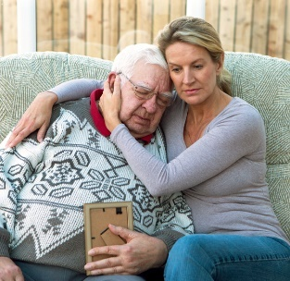
Outline (4)
Overview
Legal and financial considerations
Capacity considerations
Ethical considerations
Elder abuse

Slide 28
Ethical Considerations
Ethics: human values, what constitutes good and moral life (Whitehouse, 2000)
4 primary considerations with regard to decisions concerning PLwD (Strech et al., 2013; Whitehouse, 2000):
  Beneficence
  Nonmaleficence
  Respect for autonomy
  Privacy and confidentiality

Slide 29
Specific Ethical Concerns in Dementia Care
Ethical issues arise across all stages of dementia (Whitehouse, 2000).
  Safety, tracking/monitoring devices, medications
Care partners face many ethical challenges, particularly dilemma of caring for persons living with dementia versus meeting own needs (Hughes et al., 2002).

Slide 30
Sexual Consent
Sexual consent issues are typically of greatest concern in long-term care facilities and may also be pertinent to persons living at home.
Ability to consent to sexual activities is defined by states; it must be continuously reassessed as the person progresses through dementia (Wilkins, 2015).

Slide 31
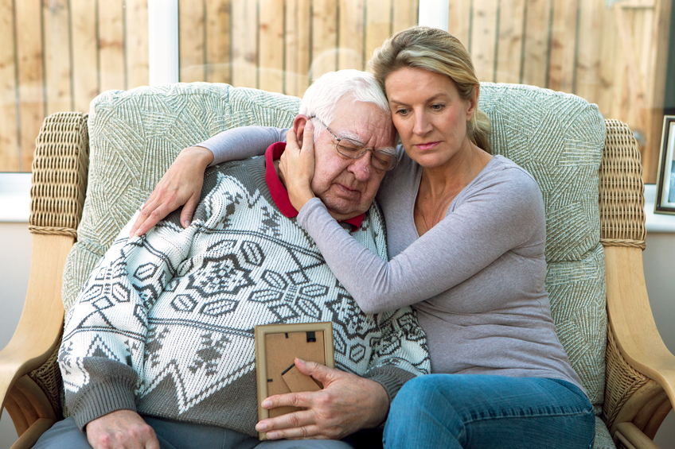
Photo – Woman consoles senior man

Slide 32
Ability to Consent to Enroll in Research
Some PLwD (and their care partners) are willing to participate in clinical studies or trials.
It is important to discuss the pros and cons of the research and to ensure that the PLwD has the capacity to provide consent.
A proxy may provide consent—but it should be consistent with the PLwD’s desires (Muthappan et al., 2005) and any legal arrangements.

Slide 33

Outline (5)
Overview
Legal and financial considerations
Capacity considerations
Ethical considerations
Elder abuse

Slide 34
Elder Abuse: Overview and Prevalence
Elder abuse can occur in any setting.
  It includes physical, emotional, sexual abuse, neglect, abandonment, financial exploitation, and fraud (U.S. DoJ, 2015).
  Definitions differ by state (NCEA 2015; NIA 2015).
  It is common but underreported (Ahmad & Lachs, 2002; Acierno et al., 2010; Lifespan, 2011).
According to a recent literature review (Dong et al., 2014):
  Psychological abuse is the most common form (62% of the elderly).
  Up to 23% of persons with dementia are victims of physical abuse.
However, many studies exclude financial abuse from their estimations (Acierno et al., 2009).
  Financial exploitation may be the most common form (Acierno et al., 2009).

Slide 35

Photo – Senior woman turning away from young woman

Slide 36
Risk Factors and Likely Perpetrators of Elder Abuse
Risk factors for elder abuse include low income, unemployment/retirement, lack of social support, and needing assistance with activities of daily living (ADL) (Acierno et al., 2009).
PLwD are at even greater risk for elder abuse than general population (Cooney et al., 2006; Vande Weerd & Paveza, 2006).
  Approximately 1 in 2 PLwD experience elder abuse (Cooper et al., 2009),
  often by caregiver (Wiglesorth et al., 2010).
The majority of perpetrators are family members (Acierno et al., 2009; Cooper et al., 2009; U.S. DoJ, 2009).

Slide 37
Case Study
Mr. Marcus was living alone in his own home. He was in the early stages
of Alzheimer's disease (MMSE 24), and his daughter was his primary caregiver. They spoke on the phone daily and she saw him about once a week. He also was receiving help from three young women who lived next-door to him. He had good retirement benefits and Social Security, yet he reported that he never had any money. His daughter found that his bank account was dwindling, and no one could understand how he was spending his money. Mr. Marcus felt that someone in the bank must be stealing money.
After some investigation, it turned out that the "helpful neighbors" were not only helping him get to the supermarket and drug store, but also to
the cash machine, several times a week. Mr. Marcus did not recall these episodes (Budson & Solomon, 2016).

Slide 38
Elder Abuse: Signs and Red Flags
All clinicians need to be aware of signs of possible elder physical abuse or neglect (Ahmad & Lach, 2002; Bonnell, 2012; Hoover & Polson, 2014; NCEA, 2013; NIA, 2015).
It is difficult to recognize signs of financial abuse.
Guidance on abuse recognition and reporting for persons living with dementia and intellectual disability can be obtained from each state’s protection and advocacy system (under the Developmental Disabilities Assistance and the Bill of Rights Act of 2000, each state has a protection and advocacy system agency designated by the state’s governor), as well as from the state’s developmental disabilities authority (state agency).
Establishment of proper guardianship (of some kind) is needed to keep people safe from such harms

Slide 39

Photo – Man scolding dejected woman

Slide 40
Elder Abuse in Diverse Populations
Ethnicities and cultural groups may define elder abuse in their own terms.
Black/African American elders are most vulnerable to financial exploitation by strangers (Beach et al., 2010; Peterson et al., 2014).
Despite few studies on Hispanic/Latino American elders (NCEA, 2016), they are apparently vulnerable to psychological abuse (Deliema et al., 2002) and reluctant to report abuse to authorities (Laumann et al., 2008).
Persons in the LGBT community are at increased risk of elder abuse by a caretaker because of homophobia (Frazer, 2009).
Persons living with dementia and intellectual disability are susceptible to various forms of abuse, including financial, sexual, verbal, and physical, which can occur in a variety of care settings (Jokinen et al., 2013).

Slide 41
Elder Abuse: Barriers to Reporting
Patient barriers to reporting involve fear of consequences
(Selwood et al., 2007).
Care partner and provider barriers involve lack of knowledge of what constitutes “abuse” (Selwood et al., 2007).
Reporting requirements vary by state and include requirements of timely reporting (Ahmad & Lachs, 2002; Hoover & Polson, 2014; NCEA, n.d.; NIA, 2015). State laws govern in large part the reporting conditions and requirements when abuse is suspected or observed in PLwD and intellectual disability (Jokinen et al., 2013).
State Protection and Advocacy System agencies in a state also have the authority to investigate abuse and neglect in any setting where a person with intellectual or developmental disability receives services under the Developmental Disabilities Assistance and the Bill of Rights Act of 2000.

Slide 42

Photo – Senior woman comforted by young woman

Slide 43
Strategies for Intervening: Elder Abuse
Ethical dilemmas:
  What is goal of intervention?
  How to balance confidentiality versus patient safety?
Strategies depend on need for involving judicial system (Ahmad & Lachs, 2002).

Slide 44
Summary
Ethical, legal, and financial considerations are associated with diagnosis of dementia.
Providers can recommend that PLwD and family/care partners seek professional counsel.
Objectivity is needed in discussing participation in clinical research.
All providers must be alert to possibility of elder abuse.

Slide 45
Evaluation
A person with dementia can designate a person of his/her own choosing to make legal or financial decisions on his/her behalf for the time when he/she is no longer able to; this person is called a:
  Guardian
  Executor
  Proxy
  Conservator
All but which of the following abilities is evaluated in a capacity assessment?
  The ability to understand key facts about a choice
  The ability to appreciate the benefits and risks of a problem
  The ability to make the right decision
  The ability to rationalize or reason

Slide 46
Evaluation (continued)
3. Which of the following is not one of the four primary ethical
considerations that should guide decision-making regarding participation in dementia research:
  Beneficence (do good)
  Nonmaleficence (do no harm)
  Respect for autonomy
  Respect for cultural beliefs
4. Which of the following might suggest a case of elder abuse?
  Dirty clothing or hair
  Bills not being paid or not paid in a timely manner
  Unexplained weight loss
  All of the above

Slide 47
Acknowledgements
This module was prepared for the U.S. Department of Health and Human Services (HHS), Health Resources and Services Administration (HRSA), by The Bizzell Group, LLC, under contract number HHSH25034002T/HHSH250201400075I.
The dementia and education experts who served on the Dementia Expert Workgroup to guide the development of the modules included: Alice Bonner, PhD, RN, FAAN, Secretary Elder Affairs, Massachusetts Executive Office of Elder Affairs, Boston MA; Laurel Coleman, MD, FACP, Kauai Medical Clinic -Hawaii Pacific Health, Lihue, HI; Cyndy B. Cordell, MBA, Director, Healthcare Professional Services, Alzheimer's Association, Chicago, IL; Dolores Gallagher Thompson, PhD, ABPP, Professor of Research, Department of Psychiatry and Behavioral Sciences, Stanford University School of Medicine, Stanford, CA; James Galvin, MD, MPH, Professor of Clinical Biomedical Science and Associate Dean for Clinical Research, Florida Atlantic University, Boca Raton, FL; Mary Guerriero Austrom, PhD, Wesley P Martin Professor of Alzheimer's Disease Education, Department of Psychiatry, Associate Dean for Diversity Affairs, Indiana University-Purdue University Indianapolis, Indianapolis, IN; Robert Kane, MD, Professor and Minnesota Chair in Long-term Care & Aging, Health Policy & Management, School of Public Health, University of Minnesota; Jason Karlawish, MD, Professor of Medicine, Perelman School of Medicine, University of Pennsylvania; Helen M. Matheny, MS, APR, Director of the Alzheimer's Disease Outreach Program, Blanchette Rockefeller Neuroscience Institute, Morgantown, WV; Darby Morhardt, PhD, LCSW, Associate Professor, Cognitive Neurology and Alzheimer's Disease Center and Department of Preventive Medicine, Northwestern University Feinberg School of Medicine, Northwestern University, Chicago, IL; Cecilia Rokusek, EdD, MSc, RDN, Assistant Dean of Research and Innovation, Professor of Family Medicine, Public Health, Nutrition, and Disaster and Emergency Preparedness, College of Osteopathic Medicine, Nova Southeastern University, Fort Lauderdale, FL. Additional expertise in the development of the modules was provided by Meg Kabat, LCSW-C, CCM; Eleanor S. McConnell, PhD, MSN, RN, GCNS, BC; Linda O. Nichols, PhD, MA, BA; Todd Semla, MS, PharmD, BCPS, FCCP, AGSF; Kenneth Shay, DDS, MS, from the U.S. Department of Veterans Affairs and Seth Keller, MD and Matthew P. Janicki, PhD, National Task Group on Intellectual Disabilities and Dementia Practices.

Slide 48
Brought to you by the
U.S. Department of Health and Human Services,
Health Resources and Services Administration

