Slide 1

The Caregiver Role in Shared Decision-Making with Persons Living with Dementia
We developed this module under a contract from the U.S. Department of Health and Human Services, Health Resources and Services Administration. The Department of Health and Human Services, Office of Women’s Health, funded this work.
Disclaimer: Some of the views expressed in this presentation module are solely the opinions of the author(s) and do not necessarily reflect the official policies of the U.S. Department of Health and Human Services or the Health Resources and Services Administration, nor does mention of the department or agency names imply endorsement by the U.S. Government.

Slide 2
Overview
The importance of shared decision-making
Decisions to make upon leaving the hospital
Long-term care options

Slide 3
Decision-Making

Slide 4
What is Shared Decision-Making?
Shared Decision-Making: Persons living with dementia, partners, involved neighbors, caregivers, family members, and their health care team make health care decisions together, taking into account the evidence available, as well as the desires of the persons living with dementia.

Slide 5
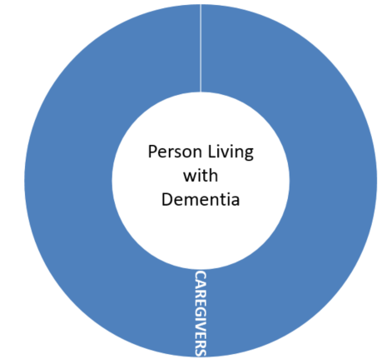
Shared Decisions

Slide 6
Guidelines
Focus on values, goals, and preferences.
Have persons living with dementia participate.
Respect differences in opinions.
Seek an advocate or mediator.

Slide 7
Treatment Decisions
Revisit treatment decisions often.
  Watch for behavioral changes.
  Address your needs and priorities.
Be aware of possible interference between dementia and treatments for other medical conditions.
Ask questions and seek additional opinions, and information.

Slide 8
Advanced Planning
Listen to wishes of the person living with dementia.
Make decisions about future care.
Discuss medical care and treatment.
Write decisions down.
Let others know the results.

Slide 9
Information Sources
Health care team
Alzheimer’s Association
Alzheimer’s Disease Education & Referral Center (ADEAR)
Administration for Community Living
Centers for Medicare & Medicaid
Eldercare locator

Slide 10
Hospital discharges

Slide 11
Hospital Discharge Process
Doctor: writes a discharge order
Discharge planner: arranges hospital release; contacts family
Patient or Caregiver: receives discharge instructions
  The discharge plan will include information on care needed after leaving the hospital, medications, warning signs, follow-up care, etc.
Care manager: consider hiring to help talk to the discharge planner

Slide 12
Planning: Hospital Discharges
Prepare to make decisions quickly.
The health of the person living with dementia may change following a hospital stay.
Work with the hospital discharge planner and medical team.
Make decisions about required, available, and affordable care.
Determine which provider you will use.

Slide 13
Before Discharge: Considerations
Should you provide more, or different, care following the hospital stay?
What are the different care options? Are they affordable?
Which care facilities have openings?
Will insurance cover some options?
Should you choose another facility while you are on the waiting list for your first choice?

Slide 14
Long Term care (LTC)

Slide 15
Overview: Long Term Care
LTC includes:
  Home health care
  Home and community-based services
  Rehabilitation unit
  Assisted living
  Nursing homes
  Hospice care
Use this 2-Step Framework tool to help you determine your best options for long-term care (LTC).

Slide 16
Option 1: Home Health Care
Definition: a Medicare service supervised by registered nurses, which provides active nursing care
Staff may also include physical, occupational, and speech therapists, and social workers.
Home health aides provide the bulk of the care.
Focus is on regaining strength, and learning tasks which allow patients to live safely at home.

Slide 17
Option 2: Personal Care
Definition: Minimally trained workers provide assistance with basic care needs at home
Nurses may supervise personal care providers.
Medicare does not cover this care, however Medicaid may cover it for certain people.

Slide 18
Option 3: Rehabilitation Units
Definition: licensed facilities that provide rehabilitation
Nurses, and physical and occupational therapists, provide most of the care to patients.
To be covered by Medicare, patients must receive at least 3 hours of therapy each day.

Slide 19
Option 4: Adult Day Health Center
Definition: Care provided outside the home in special centers
  Care may be mostly social, or may include services like physical therapy.
  Care typically includes a meal.
  Care may provide transportation to, and from, a patient’s home.
This care provides socialization for the patients, and relief to their caregivers.

Slide 20
Option 5: Assisted Living
Definition: provides personal care support services to patients living in self-contained units
  Services may include meals, medication management, bathing, dressing and transportation.
  Facility likely includes living quarters, a private bathroom, and some cooking and food storage facilities.
Independent living
Patients typically pay costs outright, but Medicaid may be used for some, depending on the state.

Slide 21
Option 6: Nursing Home
Definition: residential care for those recently discharged from the hospital, as well as longer term care
Nursing homes are required to provide nursing staff capable of caring for frail residents.
Some include special care units for persons living with dementia.
Patients pay out-of-pocket or via Medicaid.
  Medicare does not pay for nursing home stays

Slide 22
Option 7: Hospice Care
Definition: care that lessens pain and symptoms of people close to death and gives emotional and spiritual support
Most often provided at home
For people expected to live less than 6 months
Is a Medicare and Medicaid benefit that may be appropriate for many persons living with dementia

Slide 23
Choosing a Care Provider

Slide 24
Questions for Home Care Providers
What kind of therapists are available?
Is there weekend care?
Can the special needs of the person living with dementia be met?
What does it cost?

Slide 25
Questions for Residential Providers
To evaluate a nursing home, ask the questions provided in our presentation: What to Consider When Choosing a Nursing Home
To evaluate an assisted living facility, ask the questions in our presentation: What to Consider When Choosing an Assisted Living Facility

Slide 26
Summary
Decision-making is crucial for everyone’s well-being.
You will need to revisit decisions on a continual basis, especially as the person living with dementia’s health changes.
Making shared decisions can reduce stress.
Ask questions, seek out second opinions, and use the internet wisely.
Good decision-making takes considerable time and effort.

