Slide 1
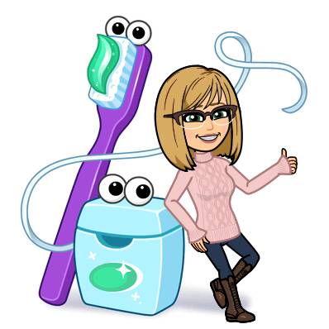
The Mouth Body Link
Carole Ferch, RDH

Slide 2
I-SMILE™ SILVER PROGRAM
Created as a result of the successful I-Smile program
Three Coordinators in the state covering 10 counties
  Scott County
  Des Moines, Lee, Van Buren
  Webster, Calhoun, Hamilton,
  Humbolt, Pocahontas and Wright

Slide 3
I-SMILE™ SILVER COORDINATOR
Help adult Iowans access dental care by providing care coordination assistance and finding payment sources for care
Partner with community organizations, health care providers, hospitals, nursing homes, and businesses to increase awareness about the importance of oral health
Educate health care providers about oral health, its role in chronic diseases and its impact on overall health
Promote oral health through news articles, displays, distributing materials, and participating in community events
Build relationships with dental offices to create referral systems for patients
Funded through Delta Dental of Iowa Foundation and HRSA

Slide 4
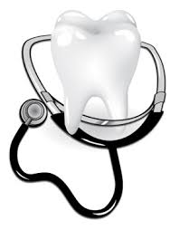
What you should know:
The health of our mouths can impact the rest of the body.
Problems in the mouth can negatively affect a person’s overall health and wellness.

Slide 5

Good Oral Health Allows People To:
Eat healthy food for good nutrition
Chew food for healthy digestion
Taste and enjoy food
Speak clearly to interact with others
Feel good about themselves
Maintain an attractive appearance

Slide 6
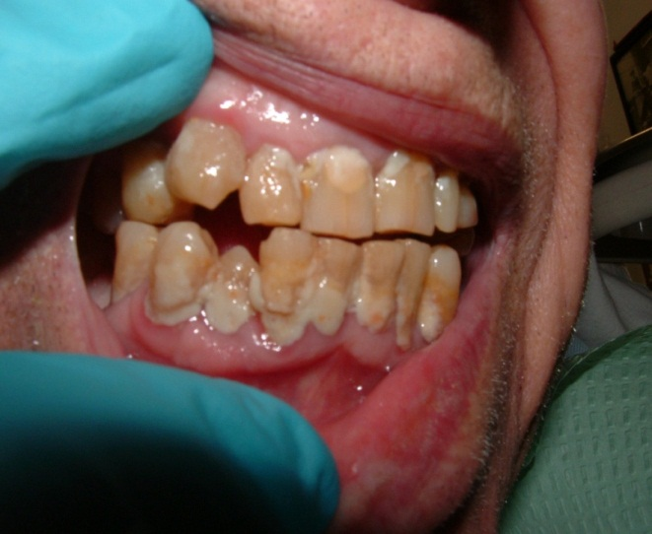
What do you see?

Slide 7

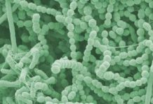
What is Plaque?
Plaque is a biofilm consisting of saliva, food, fluids and bacteria.
Plaque is a sticky, colorless film that deposits where teeth and gums meet. (that “fuzzy” feeling on your teeth)
If not brushed and flossed off regularly, the bacteria causes cavities and gum disease.
Notes:
Biofilm is a collective of microorganisms that grow on many different surfaces including plant and animal tissues.
Dental plaque also is a biofilm. As oral bacteria colonize they create a plaque consisting of saliva, food, and fluids that is sticky and colorless. We recognize it as the fuzzy feeling that forms on our teeth.
Plaque thrives in sheltered areas like where the teeth and gums meet. These bacterial colonies are easily disrupted through mechanical motions like brushing.
Biofilm…“Cities for microbes” “community lifestyle”
The human mouth is full of bacteria.

Slide 8
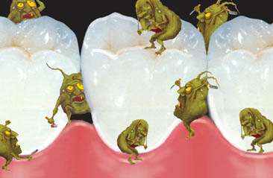
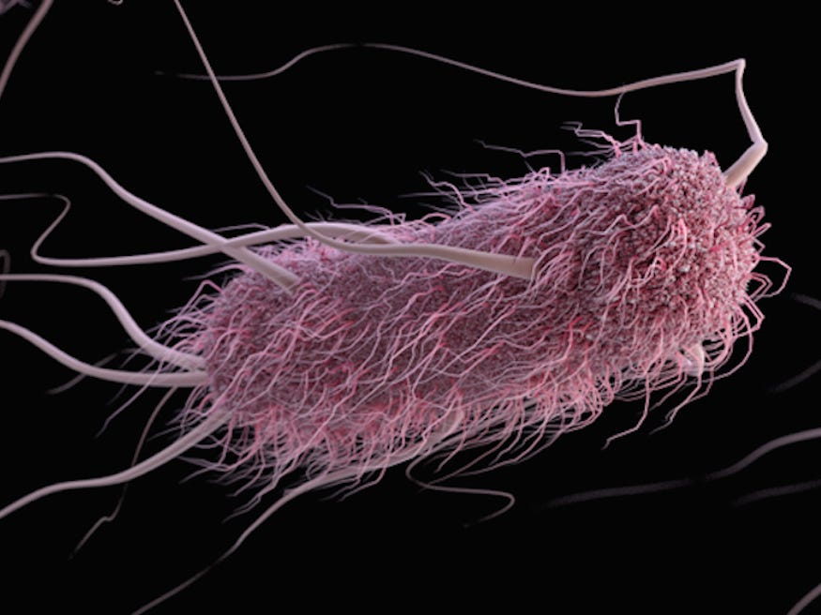
Plaque

Slide 9
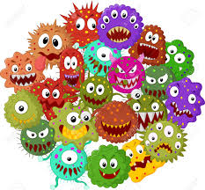
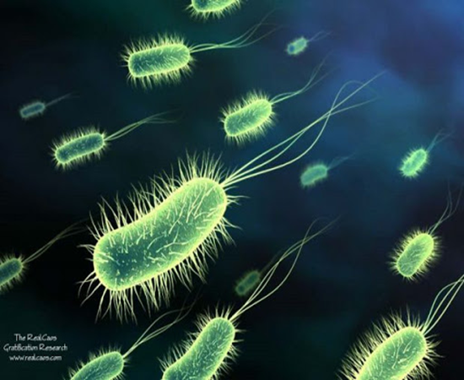
Fun Fact
Every 4-6 hours 20 billion bacteria replicate in the oral cavity.

Slide 10
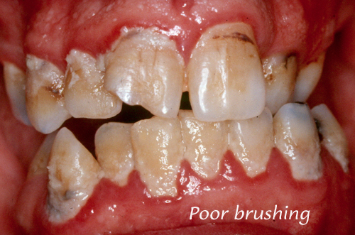
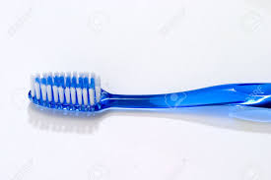
Intervention and Prevention
Plaque/bacteria can only be mechanically removed!
Notes:
The most efficient way to remove bacteria in the mouth is mechanical removal…a toothbrush is your superhero!
Remember plaque loves shelter areas and accumulates at the gum line where the tooth and gum meet.
A MINIMUM OF TWICE PER DAY IS NECESSARY FOR HEALTHY PEOPLE…MORE IS BETTER FOR VULNERABEL.

Slide 11
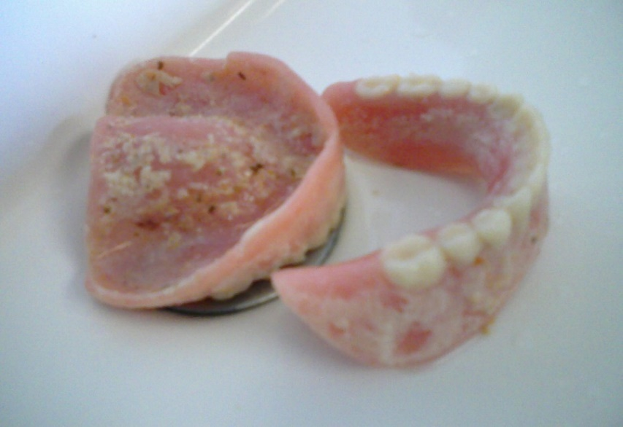
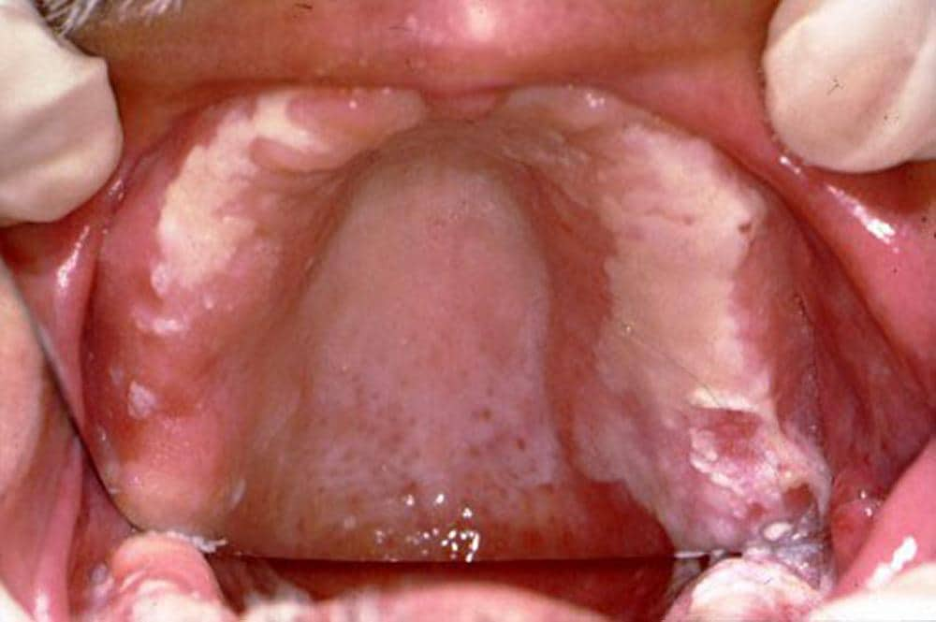
What About Dentures?
Oral care is important with or without teeth.
Plaque accumulation is only removed by brushing!
Notes:
Candida…Thrush…Yeast Infection

Slide 12
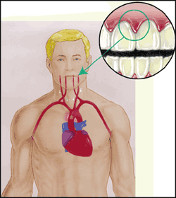
The Mouth-Body Link
A healthy mouth is especially important for frail and vulnerable patients.
Germs from unclean teeth and gums can enter the bloodstream through infected gums.
Germs from infections in the mouth can reach the heart, lung, kidneys, brain, and joints.
Notes:
The connection of the mouth to the body can be a serious issue for hospitalized patients
They may have chronic health conditions.
They likely have a weakened immune system.
They may have poor oral hygiene if they lack the ability to clean their own teeth.
They may have a dry mouth from medications.
They may have eating issues from tooth problems, swallowing difficulties, or ill-fitting dentures.

Slide 13
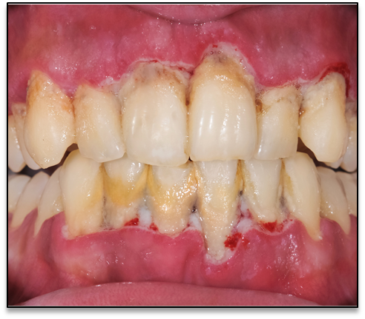
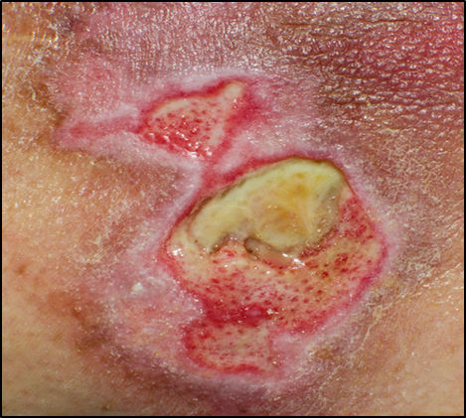
Infection is Infection
Regardless of location, the body responds the same.
Notes:
“What would you do if you woke up with an area the size of that square with oozing infection?”

Slide 14



Hospital-Acquired Pneumonia (HAP)
Hospital-acquired Pneumonia – On-set of pneumonia 48 hours after a patient is admitted.
What is HAP?
HOSPITAL-ACQUIRED PNEUMONIA (HAP) accounts for nearly 15% of all hospital-acquired infections with a mortality of 20% to 33%.
Why is it important?
Within 48 hours of admission, a patient’s normal oral flora changes to include respiratory pathogens taken on from the hospital environment.
What do we know?
Notes:
Every 4-6 hours 20 billion bacteria replicate in the oral cavity. – Remember there are laminated sheets showing bacteria formation available
RECENT LITERATURE SHOWS THAT NON-VENTILATOR HOSPITAL ACQUIRED PNEUMONIA-ALTHOUGH NOT REPORTABLE
IS NOW THE MOST COMMON HOSPITAL-ACQUIRED INFECTION
WITH HIIGHEST COST AND MORTALITY.

Slide 15
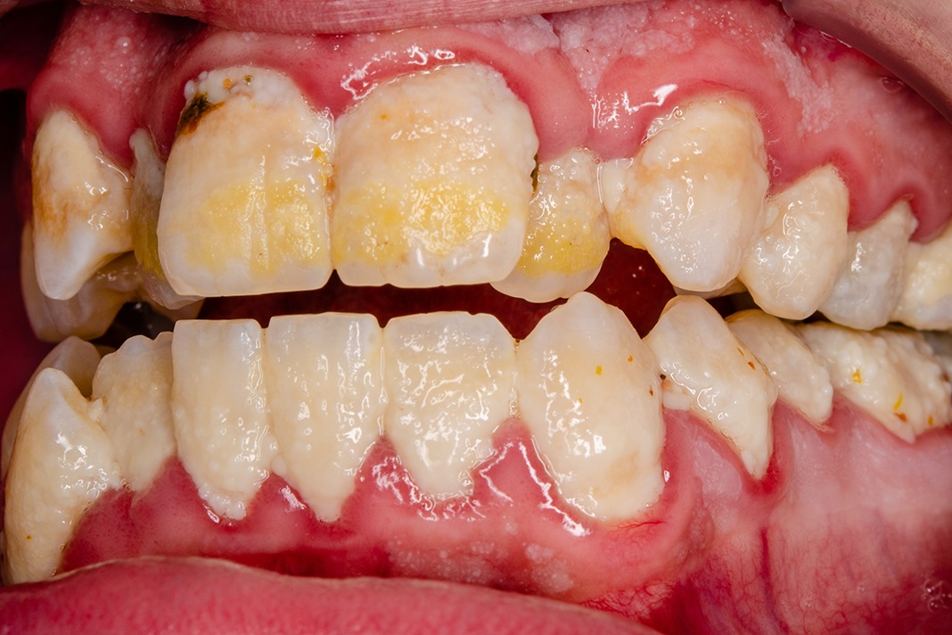
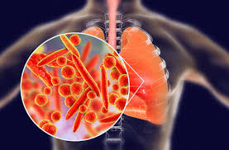
Hospital Acquired Pneumonia
Oral microbes are a significant risk factor for aspiration pneumonia.
Neglecting to remove oral bacteria can be harmful and increase the risk of gum infection & aspiration pneumonia.
Notes:
Aspiration Pneumonia: Pneumonia is a condition in which there is swelling or an infection of the small air sacs in the lungs. Aspiration pneumonia occurs when food, saliva, liquids, or vomit is breathed into the lungs.
Three predisposing key factors to HAP:
-Changes in oral microbes
-Micro aspiration
-Weakened host
Studies show that within 48 hours of admission, critically ill patients experience changes in oral bacterial colonization (gram negative organisms are more virulent).
Its important to note that even healthy adults microaspirate while sleeping caused by a supine position and drugs that suppress the central nervous system.
This is a growing problem for nursing facility residents and other seniors. Pneumonia is the number one cause of death in nursing homes.

Slide 16
Hospital Acquired Pneumonia
The most common HAI’s in the United States and occurs on every unit (i.e. maternity, pediatrics, low-risk surgery)
Studies
  Sutter Health System (Northern CA)
    Original study began with Barbara Quinn in a QI project
  Sparrow Health System (Lansing, MI)
    Funded through the Delta Dental of Michigan Foundation
Notes:
Sutter Medical Center Sacramento California
Implemented oral hygiene care 4 times a day on patients to brush away germs in the mouth
49% reduction in patients who acquired Non-Ventilator Hospital Acquired Pneumonia (NV-HAP) avoiding 60 cases in one year’s time
First Year Annual Return on Investment = $2.28 million by avoiding extra hospital days due to NV-HAP

Slide 17
What’s the Cost?
Average length of stay is 4.5 days
Patient who develops HAP increases to 9.5 days
If sepsis develops, length of stay extends to 18 days
Average cost associated with HAP is $39,897 per patient
170 HAP
7 Sepsis
16 Deaths
$6,782,490
Notes:
2018 data at a “small/medium” hospital system

Slide 18
Evidence-Based Oral Care Protocol
The AACN guideline recommends
  Oral Care 4x day
  Using soft-bristled toothbrush
  Therapeutic toothpaste
  Alcohol-free antiseptic oral rinse
  Non-Petroleum-based moisturizer
Dependent patients
  Use of suction toothbrush
Edentulate patients
  Gently brush gums/tongue and dentures 4x day
Notes:
American Academy of Critical Nursing

Slide 19
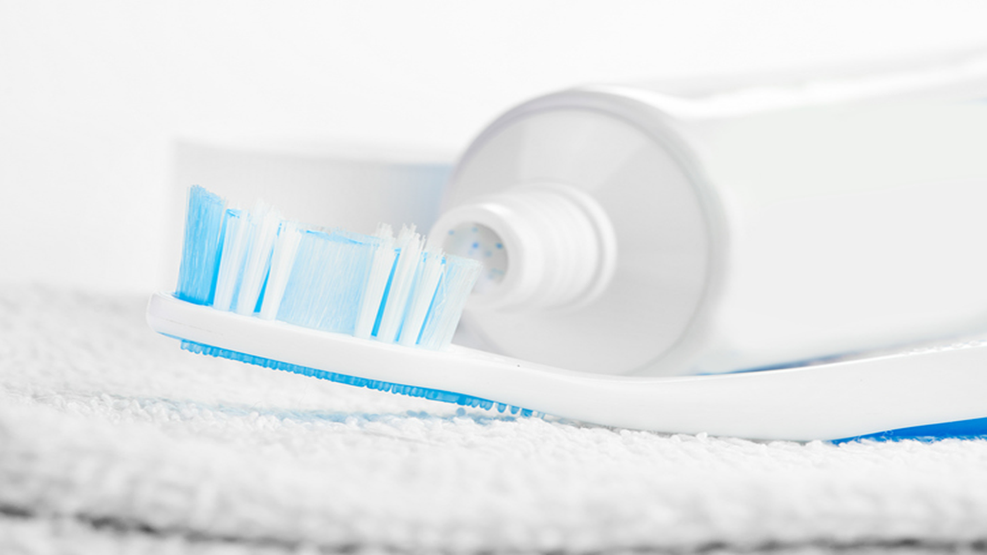
Tooth Brushing is Infection Control

Slide 20
References
American Nurse Today, Volume 10, No. 3 March, 2015
American Journal of Nursing, Volume 119 No. 2 February, 2019
Clinical Infectious Diseases, 2005 January
Journal of the American Geriatrics Society, (September, 2008)
National Institute of Dental & Craniofacial Research
National Institute of Diabetes and Digestive and Kidney Disease
Materials adapted from resources developed and provided by Jane Chalmers, BDSc, MS, PhD and Howard Cowen, DDS, MS,DABSCD, University of Iowa College of Dentistry; Carol Van Aernam RDH,BA; Delta Dental Washington Dental Service Foundation
International Society of Vascular Behavioral and Cognitive Disorders
YONEYAMA, Oral Care Reduces Pneumonia in Older Patients, JAG, Vol. 50, Issue 3, 3/2002

Slide 21
Carole Ferch, RDH
Community Dental Consultant
I-Smile™ Silver Coordinator

